Slide 1
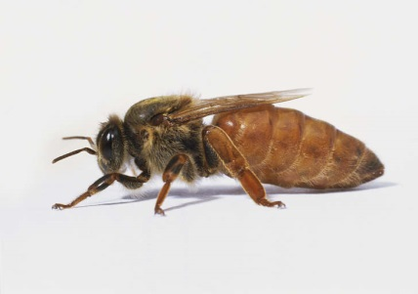
Gold Coast Regional Beekeepers Inc.
The Queen
Prepared by John Polley

Slide 2
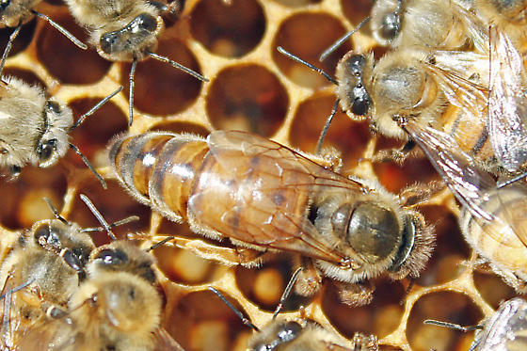
The Queen Bee
The queen bee is the heart and soul of the honey bee colony. She is the reason for nearly everything the rest of the colony does. The queen is the only bee without which the rest of the colony cannot survive. A good quality queen means a strong and productive hive.
Notes:
As a beekeeper, on every visit to the hive you’ll need to determine “Do I have a queen?” and “Is she healthy?”
Only one queen lives in a given hive. She is the largest female bee in the colony, with a long and graceful body. She is the only female with fully developed ovaries. The queen’s two primary purposes are to produce chemical scents that help regulate the unity of the colony and to lay lots of eggs. She is, in fact, an egg-laying machine, capable of producing between 1,500 and 2,500 eggs a day at 30-second intervals. The weight of that many eggs is more than her body weight!
The other bees pay close attention to the queen, tending to her every need. Like a regal celebrity, she’s always surrounded by a flock of attendants as she moves about the hive, they feed, groom and attend to her every need, yet, she isn’t spoiled.

Slide 3
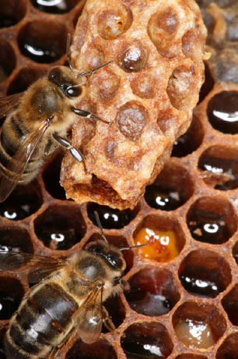
The Queen Cell
Two nurse bees watch over a queen larva in its cell and feed it Royal Jelly
Notes:
A special cell in which Queens are reared. Larger that a worker or drone cells and positioned vertically not horizontally, have a pointed tip at their base, and stand out from the perfect regularity of the comb frame. If the cell is built in the centre of a brood frame it will be a supersedure queen, if along the bottom of the frame, a swarm queen

Slide 4
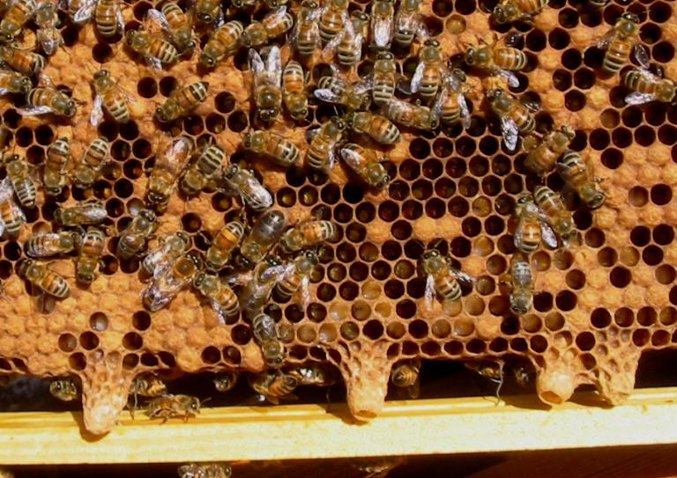
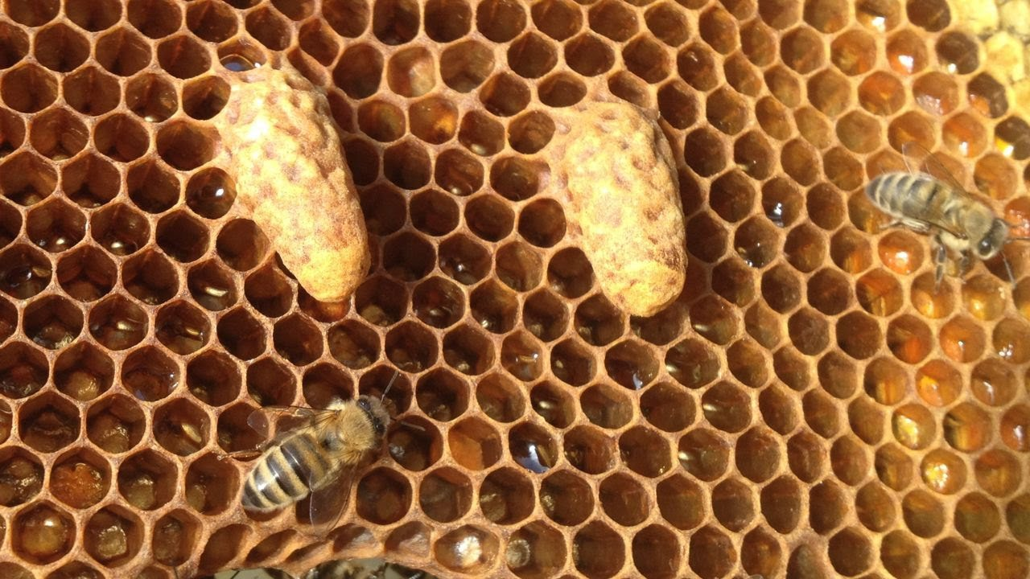
Queen bee SWARM cells
Queen bee SUPERCEEDURE cells

Slide 5
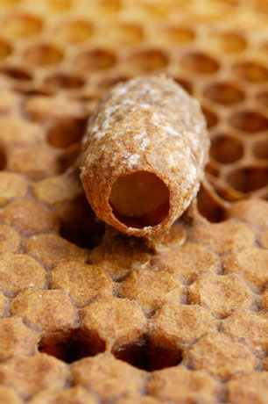
Perfectly symmetrical royal cell hangs head down from a comb.
Notes:
This cell has not yet been sealed by the bees and one can see a six day old larva exclusively feed on royal jelly.
Royal cell hangs head down from a comb.

Slide 6
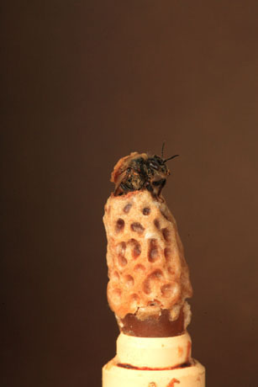
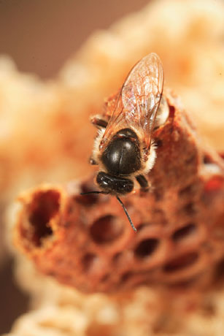
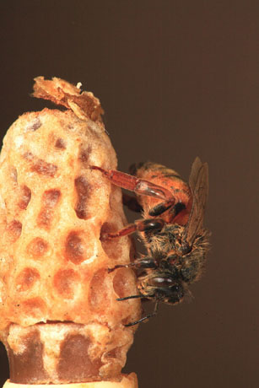
The Queen Emerges
The Queen emerging from the Queen cell

Slide 7
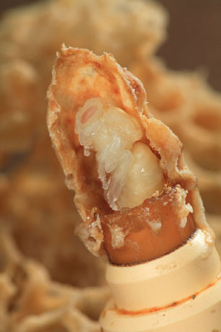
Section of a queen-rearing cell removed to expose the Pupa during it’s metaphoric transformation.

Slide 8
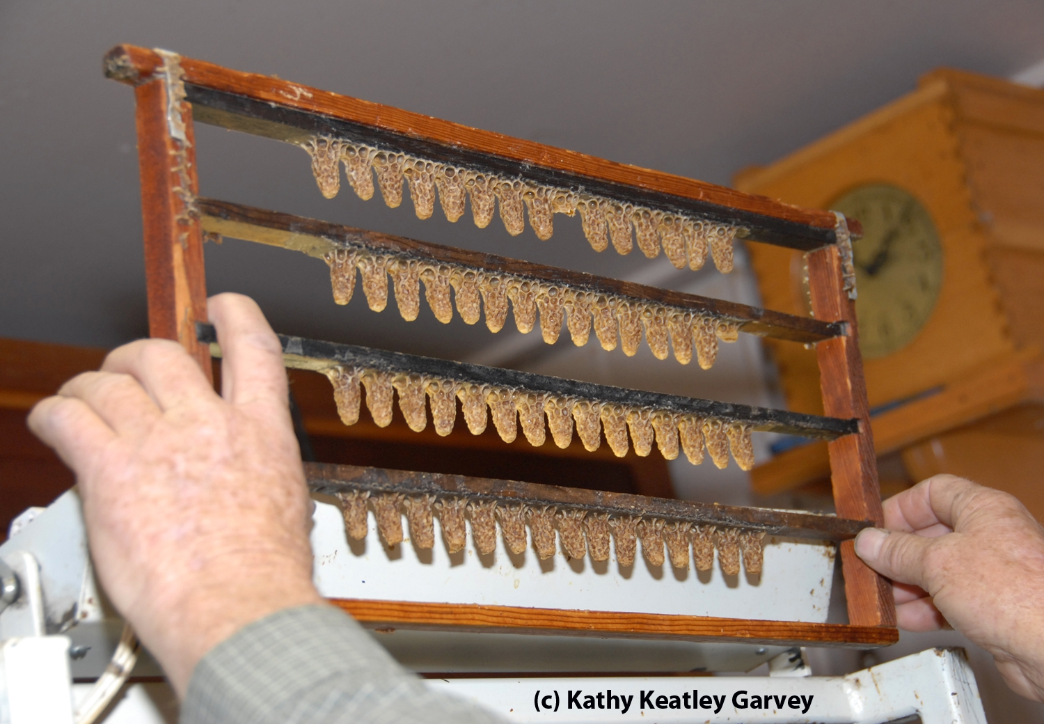
A Queen bee breeder checking a frame of brood

Slide 9
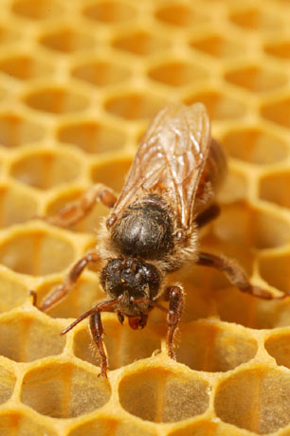
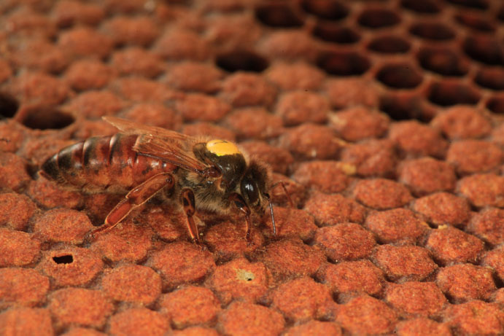
Frontal and side view of a queen alone on uncapped and capped brood comb. The cells and the pupa’s they contain have been sealed by workers for the final transformation to occur.

Slide 10
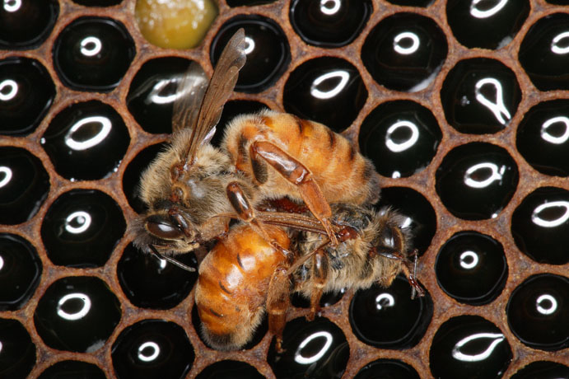
At birth, the young queen starts looking for her sisters to eliminate them. If the queen meets one of them, a fight to death ensues.
Notes:
Armed with a smooth stinger a queen can stings her rivals without losing her stinger thus surviving the fight.

Slide 11
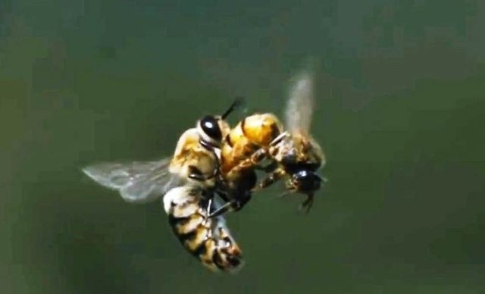
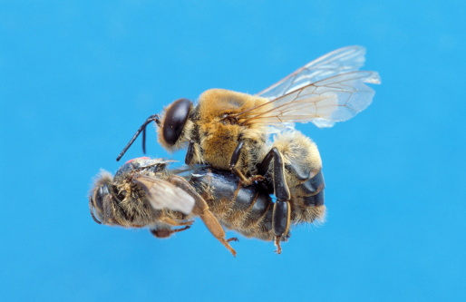
Queen bee mating in flight
Mating occurs in flight over ten meters above ground. The young queen, born five to six days earlier, has only ventured out of the hive for her reconnaissance flight. When sexually mature, she leaves the hive on a fair windless day and mates with about a dozen males to fill her spermatheca. Mating results in death for the drones.
Notes:
When a virgin queen flies to a site where thousands of male honey bees may be waiting, she mates with several males in flight. A male drone will mount the queen and insert his endophallus, ejaculating semen. After ejaculation, a male honey bee pulls away from the queen, though his endophallus is ripped from his body, remaining attached to the newly fertilized queen. Virgin queens mate early in their lives and only attend one mating flight. After several matings during this flight, a queen stores up to 100 million sperm within her oviducts. However, only five to six million are stored within the queen’s spermatheca. The queen uses only a few of these sperm at a time in order to fertilize eggs throughout her life. If a queen runs out of sperm in her lifetime, new generations of queens will mate and produce their own colonies.
Honey bee queens control the sex of their offspring: as eggs pass through the ovary into the oviduct, a queen can determine whether a particular egg is fertilized or not. Unfertilized eggs become drone honey bees, while fertilized eggs develop into female workers and queens. Female workers do not mate, but they can lay infertile eggs, which in turn become male honey bees.

Slide 12
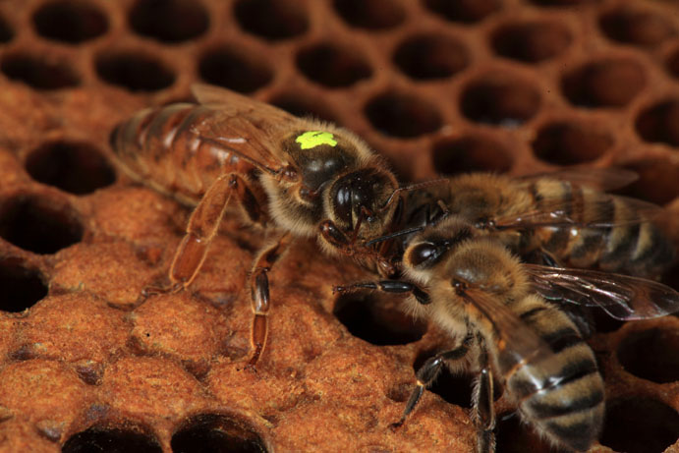
A queen moves on a frame with the workers (her daughters) looking for honey. Her head has developed mandibles. Her thorax is larger than that of ordinary bees and the abdomen, which contains fully developed genital organs, is very developed. It can double in size during the laying period.
Notes:
These royal attendants are vital, because the queen is totally incapable of tending to her own basic needs. She can neither feed nor groom herself. She can’t even leave the hive to relieve herself. And so her doting attendants (the queen’s court) take care of her basic needs while she tirelessly goes from cell to cell doing what she does best . . . laying eggs. The gentle queen bee has a stinger, but it is rare for a beekeeper to be stung by a queen bee. In general, queen bees use their stingers only to kill rival queens that may emerge or be introduced in the hive.

Slide 13
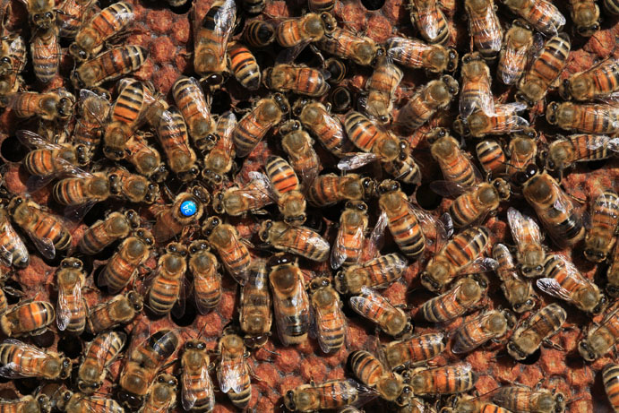
The queen, marked by the beekeeper, is laying eggs surrounded by her retinue. A few bees lick her body and a large number of bees touch her with their antennae's. Marking queens allows beekeepers to identify queens, to know their age and their laying cycles.
The gentle queen bee has a stinger, but it is rare for a beekeeper to be stung by a queen bee. In general, queen bees use their stingers only to kill rival queens that may emerge or be introduced in the hive.
Notes:
The queen can live for two or more years, but replacing your queen after a couple of seasons ensures maximum productivity. Some beekeepers routinely replace their queens every autumn. That practice ensures that your hive has a new energetic young queen each spring. You may wonder why you should replace the queen if she’s still alive? That’s an easy one: As a queen ages, her egg-laying capability slows down, which results in less and less brood each season. Less brood means a smaller colony. And a smaller colony means a lacklustre honey harvest for you!
As a beekeeper, your job is to anticipate problems before they happen. An aging queen — more than a year old — is something that you can deal with by replacing her after checking her egg laying before you have a problem.

Slide 14
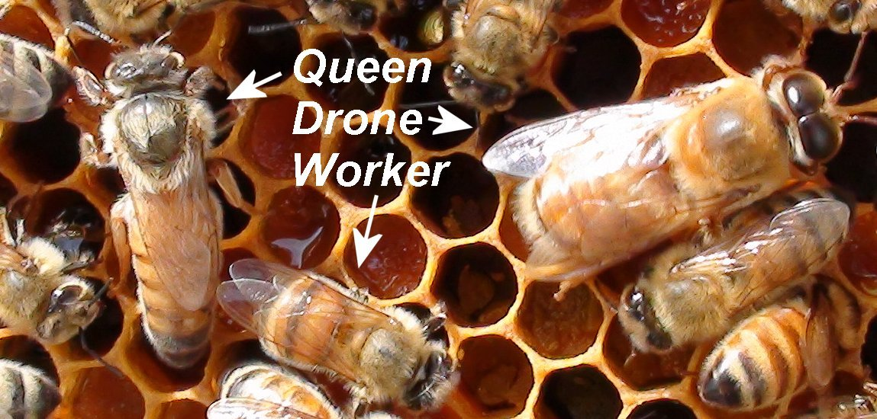
The Queen laying an egg into a prepared cell

Slide 15
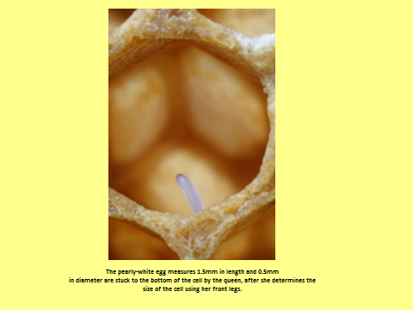

Slide 16
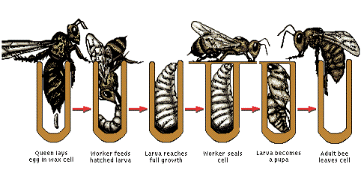
1
3
6
9
18
16

Slide 17
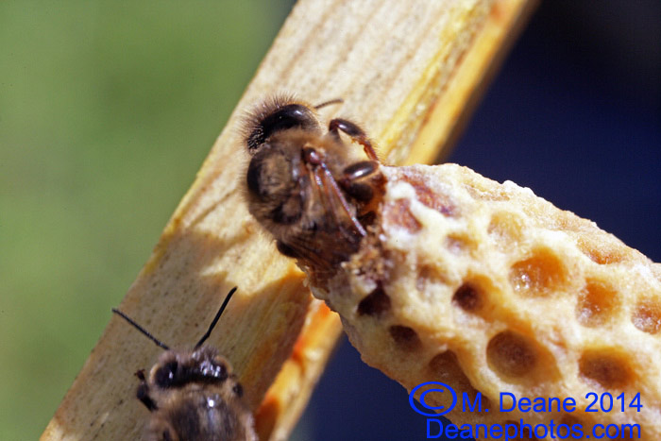
Queen bee emerging from her cell

Slide 18
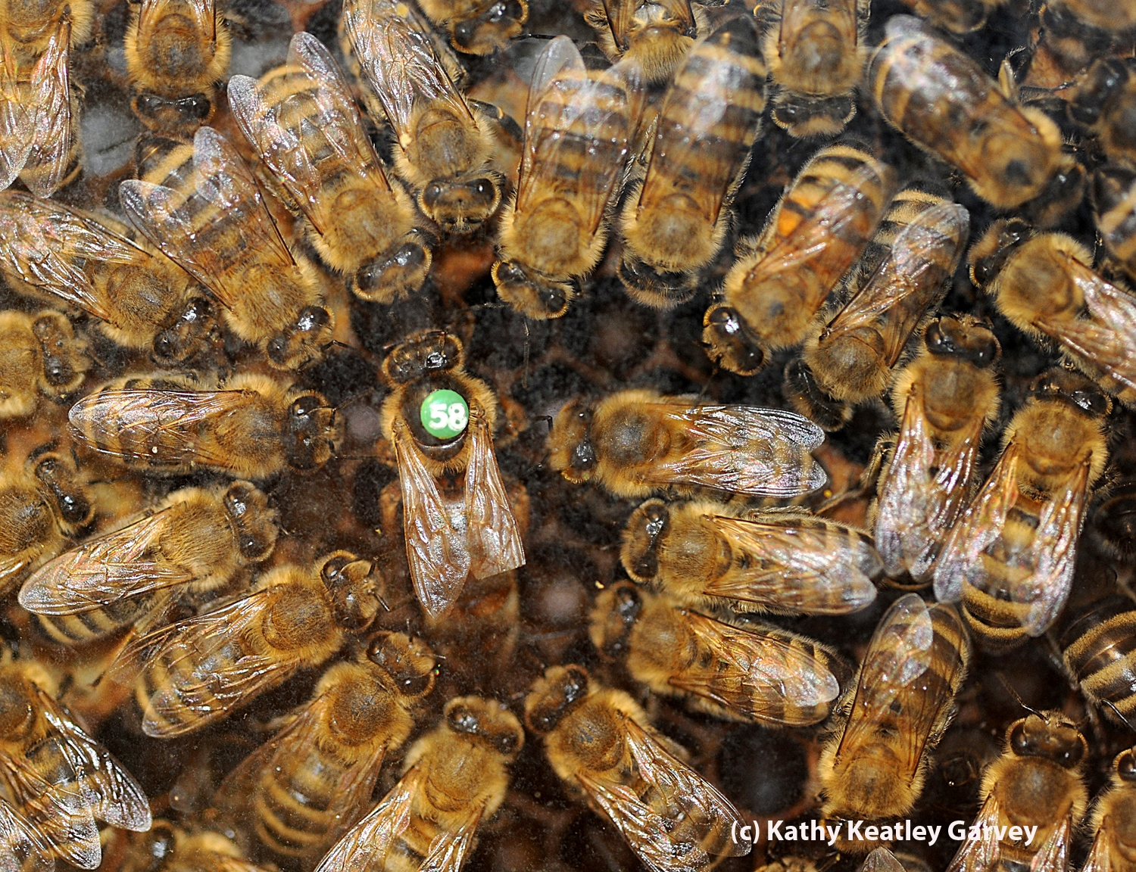
Can you find the Queen

