Slide 1
The Gold Coast Regional Beekeepers Inc.
Working the Hive
Notes:
Welcome to the Gold Coast Regional Beekeepers Inc.'s Introduction to Beekeeping Seminar.
Feel free to talk to any of our members and ask any questions that you may have regarding bees, beekeeping and pollination.
Some of our members are not as agile as they once were, but the knowledge they have about beekeeping would fill many a book, so please take advantage of their knowledge and experience take your first steps towards becoming a beekeeper.

Slide 2
*What
*When
*How
What to do
Everyone who own or manages a hive must be able to:
Open and close the hive.
Remove and/or replace frames in the hive.
Inspect the frames for eggs, larvae or Pupa.
Find the Queen.
Detect a range of diseases such as Small Hive Beetle (SHB), American Foul Brood (AFB), European Foul Brood (EFB), Chalkbrood and other diseases.
Carry out general maintenance to the hive
Notes:
These are some of the basic aspects of beekeeping that you need to be familiar with

Slide 3
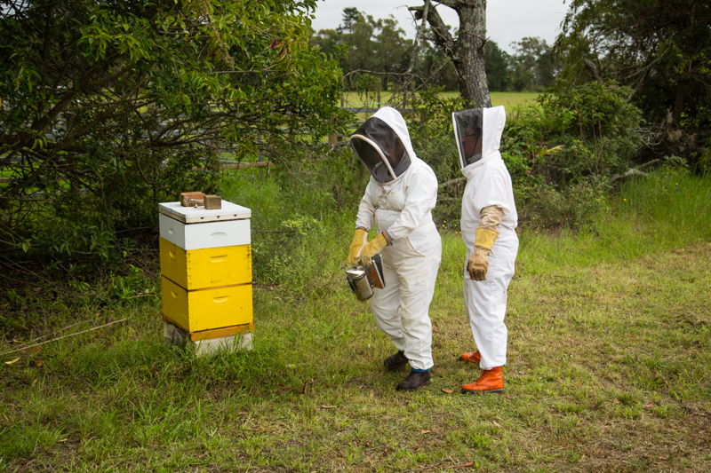
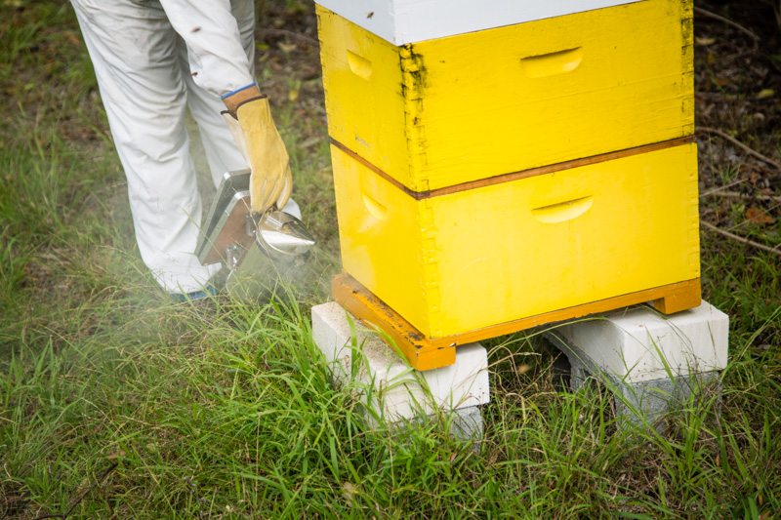
Opening & Closing the hive
Approach the hive from the rear or side
Stand at the side and give a few gentle puff of smoke
Notes:
How to approach the hive, keeping the bees flight path clear

Slide 4
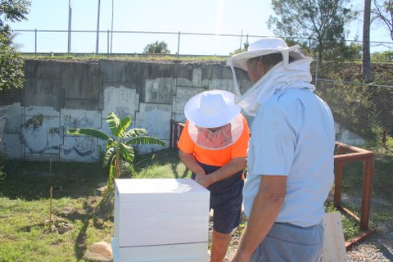
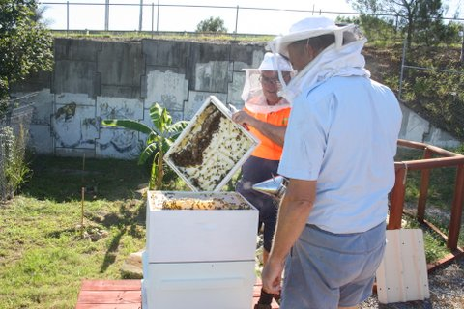
Using your hive tool, gently ease the flat surface between the bottom of the lid and the top of the super box to prise them apart
Once the seal has been broken remove the lid and place to the side upside down, while gently smoking the hive if necessary
Notes:
How to use your hive tool
Insert the curved end of your hive tool between the first and second frames, near one end of the frame’s top bar.
Twist the tool to separate the frames from each other. Repeat this motion at the opposite end of the top bar.
Using your hive tool, loosen frame two and move it into the open slot where frame one used to be. That gives you enough room to remove this frame without the risk of injuring any bees. When you’re done looking at this frame, return it to the hive, close to (but not touching) the wall. Do not put this frame on the ground.
Work your way through all ten frames in this manner, moving the next frame to be inspected into the open slot. When you’re done looking at a frame, always return it snugly against the frame previously inspected. Use your eyes to monitor progress as the frames are slowly nudged together.

Slide 5
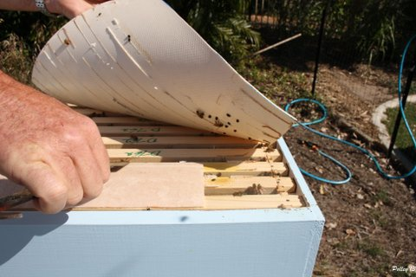
Checking for Small Hive Beetle
Small Hive Beetle
The Velcro like backing on vinyl floor sheeting catches their legs then the bees attack and kill them.
Notes:
Become friends with your local flooring shop, it is amazing what a jar of honey can get for you

Slide 6
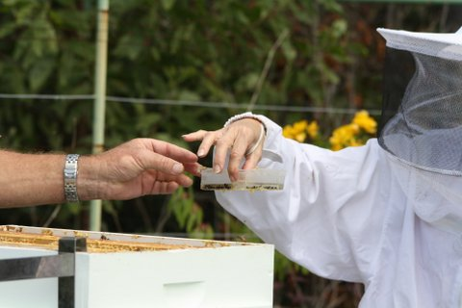
Removing a Small Hive Beetle trap
SHB in the oil filled trap
Notes:
How to remove and replace SHB traps of various kinds

Slide 7
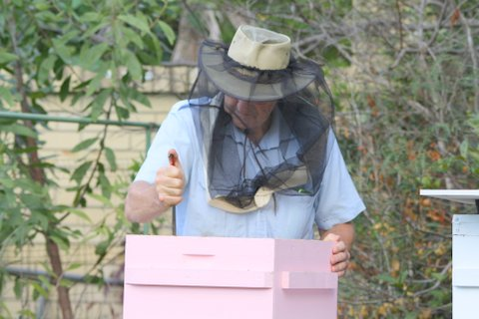
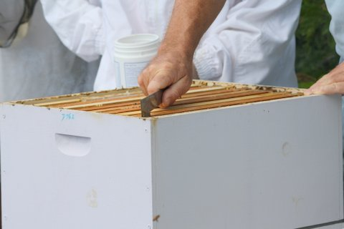
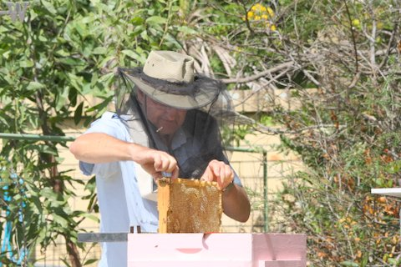
Carefully Remove the frame
Using the hive tool carefully break the propolis seal between frames then gently lift the frame
Notes:
Remain calm and treat your bees gently, The smoother your movements are the less aggravated the bees become

Slide 8
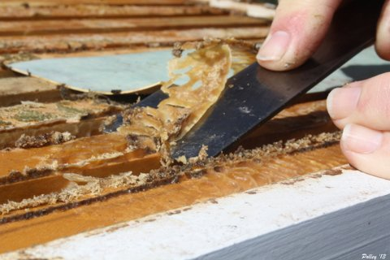
Propolis
Propolis, a bee glue made from gummy, resinous substances gathered by the bees from various plants, mixed with wax and saliva and used to seal cracks and as an anti-bacterial agent in the hive.
Sought by people for its health benefits
Notes:
Have a small container available to put the propolis scrapings into as it is sought after by many people

Slide 9
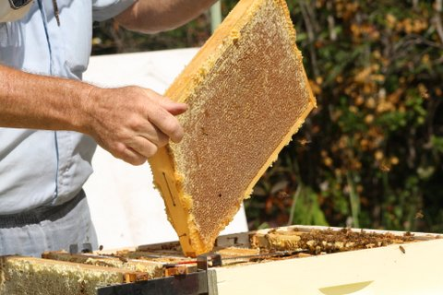
A fully capped frame of honey
Small Hive Beetle
Notes:
Always keep a watch for small hive beetles, they are small and move fast, squash them when you can

Slide 10
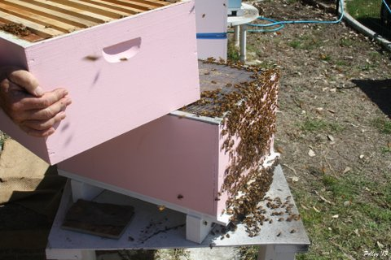
Removing the super and queen excluder
Super
Queen excluder
Brood box
Bottom board
Removing the super to check the brood and queen beneath the queen excluder.
Notes:
Be gentle when handling the hive supers

Slide 11
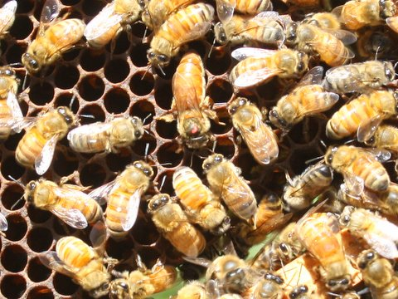
Finding the Queen
The Queen bee
Notes:
Queens are not born with a coloured spot on their heads, a kind queen bee rearer applies the at $1 a dot

Slide 12
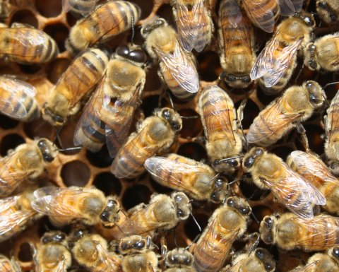
See who else is at home
Drone bee
My, what lovely big eyes you have !!
Notes:
Drones are easily identified by their size and large eyes

Slide 13
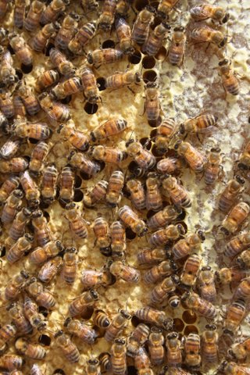
Brood Frame
Sealed brood
Stored honey
Notes:
Learn to identify between sealed brood and capped cells of honey

Slide 14
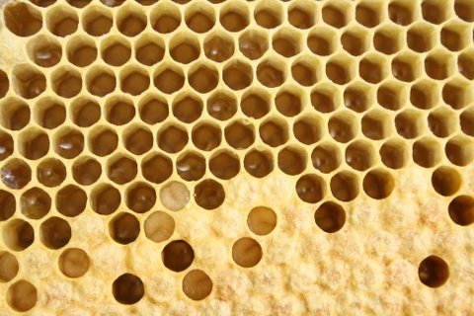
Brood Frame
Larvae
Eggs
Sealed brood
(Pupa)
The various stages of brood
Notes:
The larval and pupa stages of an insect's development are consecutive but very different. The larva is generally a worm-like creature that emerges from the egg, the first life stage. The pupa is the seemingly sedentary, transformative form following the larval stage. Going through both stages to reach adulthood is defined as complete metamorphosis in insects.

Slide 15
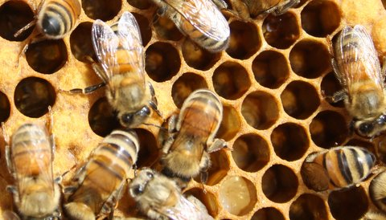
Worker bees
Typical of the female species
They do all the work while all the Drones do is mate with the queen
Notes:
They Clean, build, raise the brood, feed the queen, brood and drones, guard the hive and forage for nectar, pollen and propolis.

Slide 16
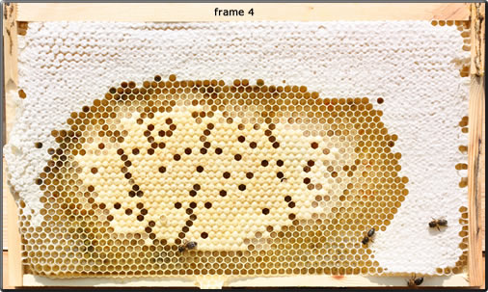
Brood Pattern
on a new frame with a newly mated queen
Capped Honey
Empty Cells
Larvae uncapped
Capped Brood
The frames above show the pattern of brood produced by a new colony with a newly mated queen. The small colony was given a new brood box with all new frames containing foundation. The first 10 days were spent by the bees drawing out the first frames and storing some honey. The first eggs were seen after 10 days.

Slide 17
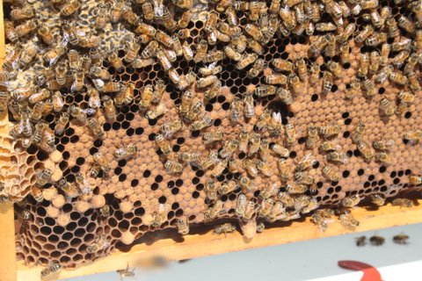
Old brood frame with capped cells, drone cells and queen cell
Brood cells
Drone cell
Swarm Queen cell
Notes:
These are some of the things that you need to learn to identify

Slide 18
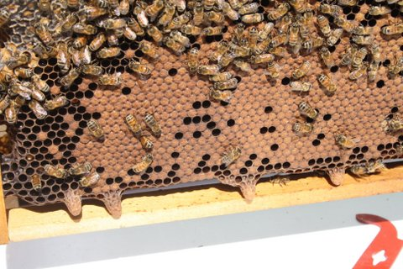
Signs that the queen is not strong,
has swarmed or is about to
Swarm Queen cells

Slide 19
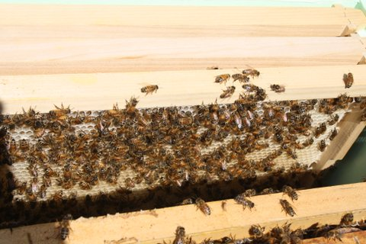
New Frame with cells being built
New cells being built out
Notes:
Nice new frames, try to rotate your brood frames up into the honey super at least yearly

Slide 20
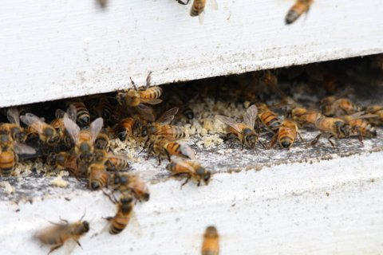
ROBBER BEES Signs to be wary of
Crumbs of wax
Robbing
Robber Bees - let the brawl begin
Notes:
Robbing occurs during a dearth of nectar. That can mean before the flowers begin blooming in the spring or it can mean in the height of summer, after the spring bloom and before the fall bloom. The bees have little to forage on and are drawn to the smell of honey in neighbouring hives. If the bees can successfully challenge and overcome the guard bees of a weak hive, they will enter the hive and begin robbing. They will then return to their own hive to recruit more robbers. If not stopped, a frenzy of fighting, killing, and robbing will ensue. Soon you may have piles of dead bees and torn-up wax in front of a doomed hive.

Slide 21
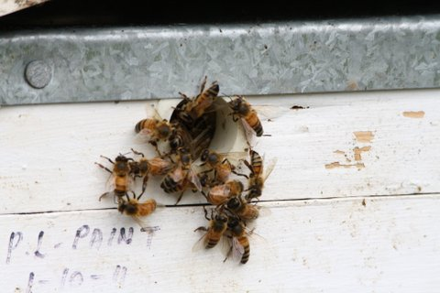
The fight goes on

Slide 22
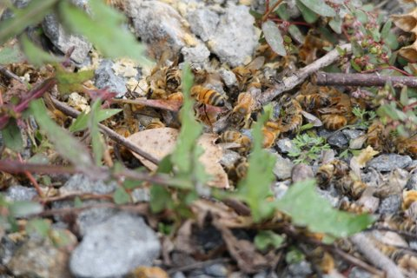
Casualties are heavy,
and the hive is lost
Notes:
Weak hives need plenty of attention, reduce the hive back to a single brood box until they have greater numbers

Slide 23
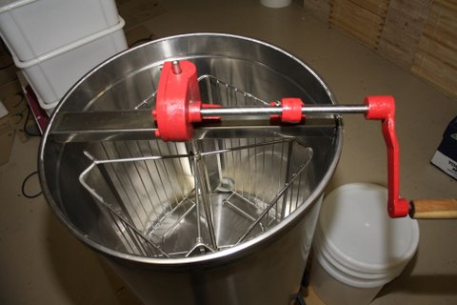
Manual honey extractor - 4 frame
4 Frame cages
Notes:
Now comes the part that you have all been waiting for… Producing your own honey and how to go about extracting the honey from the frames
The main equipment needed for this exercise is an Extractor, these can be hired from the club

Slide 24
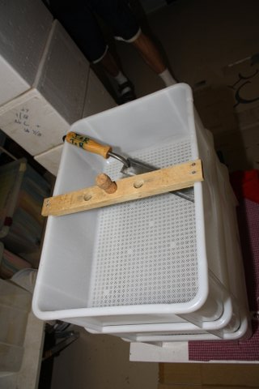
Uncapping box & electric uncapping knife
electric uncapping knife
Frame rest board with safety cork covering spike
2 layers of wax draining tubs.
Solid bottom tub with honey gate for draining honey
Notes:
An uncapping box and knife, in this case it is an electric model. You can use a long bladed knife heated in boiling water, and electric knife or if you can get your hands on one, a steam model

Slide 25
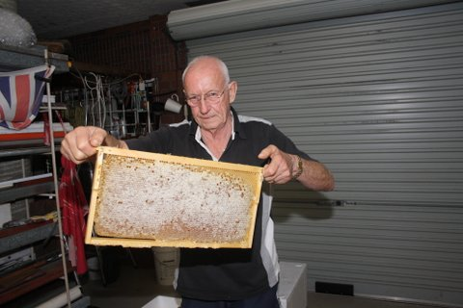
Full capped frame of honey
A fully capped frame of honey can weigh between 3kg to 5kg
Notes:
Once taken from the hive the frames are best kept in a sealed container or box until extraction starts

Slide 26
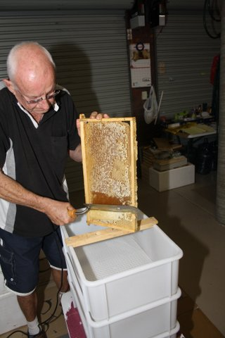
Uncapping a frame using a electric uncapping knife
Notes:
The timber cross piece has a spike protruding to balance the frame on.
Resting your hot knife on both sides of the frame slowly draw it down the capped frame to remove the wax covering, letting the wax fall into the uncapping box to drain

Slide 27
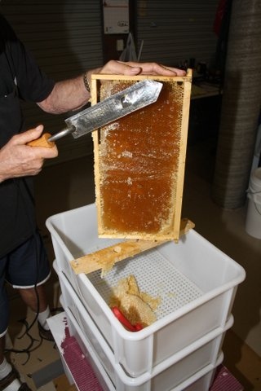
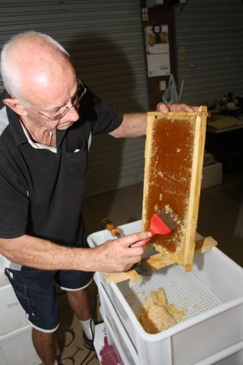
Using
uncapping comb
Wax capping's
Notes:
Any area missed by the knife can be Scratched using an steel comb to open the cells

Slide 28
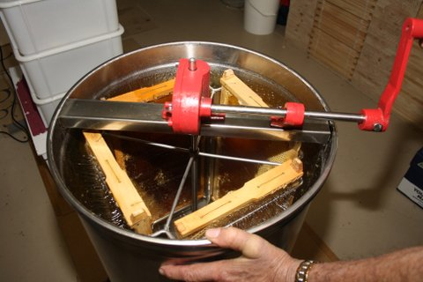
4 uncapped frames in extractor
Notes:
The uncapped frames are then placed into the extractor frames ready to be spun out

Slide 29
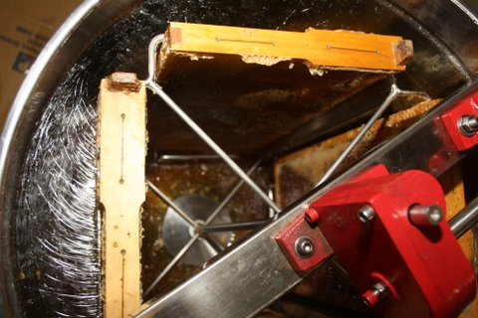
Honey being spun from the frame using the centrifugal force
Honey being spun out
Pool of extracted honey forming in the base of the extractor
Notes:
Centrifugal force draws the honey from the cell and throws it against the wall of the extractor. It then drains to the bottom of the barrel and pools before being released through the honey gate at the base.

Slide 30
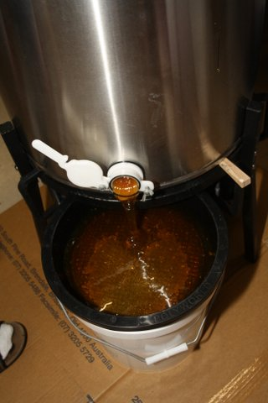
Honey gate open, draining
honey from the extractor
Extractor
Honey gate
Liquid Gold
HONEY
Double stainless steel filter
20 litre pail
Notes:
Extracted honey is drained from the extractor tank into a 20 litre pail. Be sure to check the honey level in the pail as each frame can hold between 2 Kg and 3.5 Kg, so check the pail level after every set of frames extracted

Slide 31
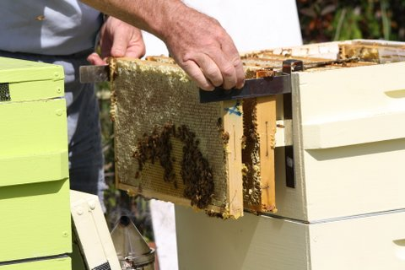
Using a frame support bracket
This bracket hold frames during hive inspection
Notes:
When inspecting the hive these frame holders are very handy

Slide 32
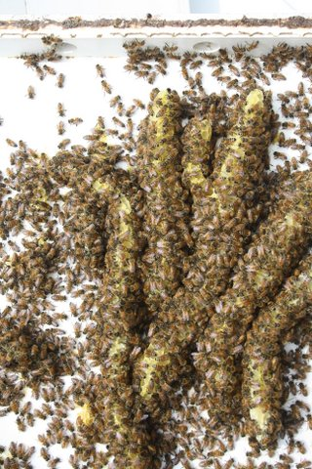
Burr combe in the hive lid
Burr comb built under a lid
Notes:
Burr comb is the honeycomb bees build to make their hive conform to bee space. A colony of bees will not leave a section of their hive free and open. They will fill it. Should you remove a frame or if your hive does not conform to bee space, your bees will fill in the gaps, holes and spaces with burr comb. Some beekeeping manuals define burr comb as that rogue comb found on the walls and floor of the hive, but any unwanted comb in the hive is typically referred to as burr comb.
Bee space is a passageway 1/4- to 3/8-inches wide (6-10 mm) that bees use for moving throughout the hive. In 1851 the Reverend L. L. Langstroth realized that spaces narrower than this were treated like cracks and filled with propolis. Spaces wider than this were treated like construction zones–bees donned their hardhats and filled the areas with burr comb.
Bees–being a little neurotic–like to have their passageways just large enough to fit through: no more, no less. And they never build tunnels through their comb. Every bee, following the unwritten rule, walks around the edges of comb to get to the other side.

Slide 33
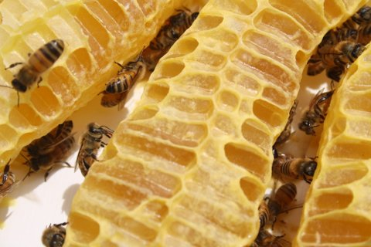
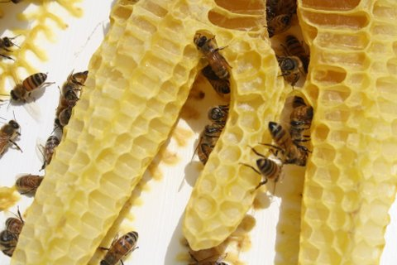
Burcomb
Burr comb cells full of honey
New wax cells

Slide 34
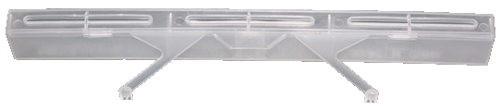


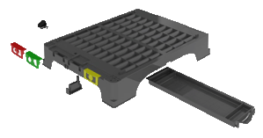
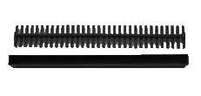
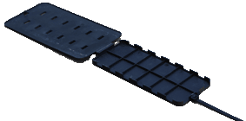
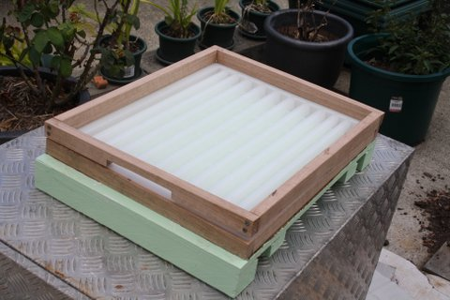
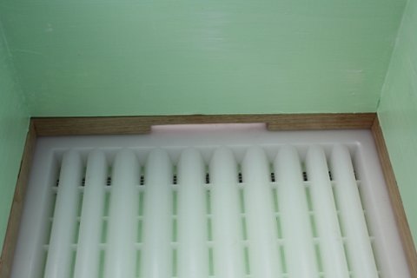
Types of SHB traps
Beetle Jail
Beetle Blaster
AJ’s Beetle Eater
Hive Doctor Base
DE Beetle Trap
Bluebees Brood Box Bottom Board
(frame needs to be made to fit)
Notes:
These are some of the more commonly used SHB traps

Slide 35
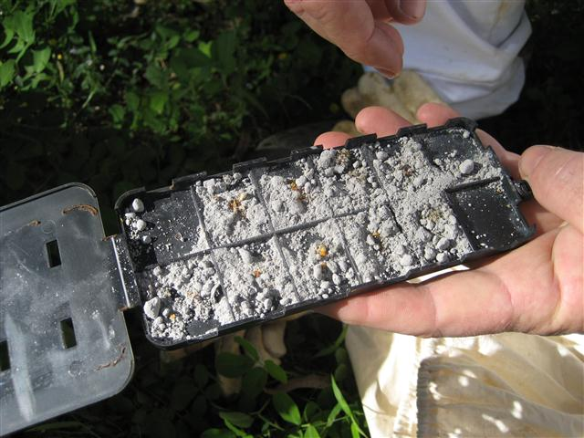
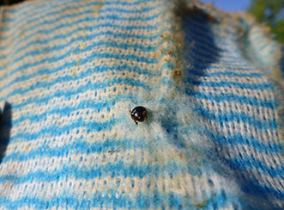
DE beetle trap filled with Diatomaceous Earth
Underside of Vinyl Sheeting
The good old Chux cloth

Slide 36
Hive Records
Hive record 2009 |  |  | Hive no. | 4 |  |  |  |  |  | History: | Nuc from hive 2, Oct 2013, |  |  |  | Queen marked: White
Home apiary |  | P772 |  |  |  |  |  |  |  |  | 35kg honey 2013.
Date | Weather | Queen | Q' cells | Eggs | Larvae | Stores | Decks | Temper | SHB | AFB | EFB | C/Brood | Varroa | Wmoth | Notes
3-Sep | Fine | Y | No | Y | Y | Y | 2 | Good | Y | N | N | N | N | N | May need new super next week.
12-Sep | Fine | N | N | Y | Y | Y | 2 | Good | Few | N | N | N | N | N | Took 6 Frames Honey (16kg) no insp Brood
1-Oct | Fine | Y | 1 (X) | Y | Y | Y | 2 | Good | N | N | N | N | N | N | Hive very busy - ready to split
21-Oct | Fine | Y | N | Y | Y | Y | 2 | Good | N | N | N | N | N | N | Split Hive 4- 3 frames brood- left split
” |  |  |  |  |  |  |  |  |  |  |  |  |  |  | box above H4 for 4 days seperated
” |  |  |  |  |  |  |  |  |  |  |  |  |  |  | introduced new queen New Hive No.9
29-Oct | Fine | N | N | Y | Y | Y | 2 | Good | N | N | N | N | N | N | Checked SHB traps Hive very busy
15-Nov | Fine/Hot | Y | N | Y | Y | Y | 2 | Good | Few | N | N | N | N | N | Took 7 Frames Honey (17kg) Q+Brood good
An important aspect of successful beekeeping is that of keeping accurate records.
Notes:
They allow you to know what is, and has been, going on inside your hives, which in time should provide useful data that will help you manage your stocks more effectively. From your records you should be able to tell what has been done during any manipulations of the colony, what needs to be done and what did and didn’t work. Your records will also be useful during inspection by any inspector or for submitting to authorities should you have any notifiable diseases.
The approach for inspecting your beehive doesn’t vary much from one visit to another. Beekeepers always follow certain procedures and always look for certain things. After a few visits to the hive, the mechanics of all this become second nature, and you can concentrate on enjoying the miraculous discoveries that await you.

Slide 37
 |  |  |  | Hive Inspection Sheet
Hive No. …….. |  |  |  | Date | / | /
Brood Box Configuration | 1 | 2 | 3 | 4 | 5 | 6 | 7 | 8 | 9 | 10
Frame with Foundation | Y | Y | Y | Y | Y | Y | Y | Y | Y | N
Drawn Comb | Y | Y | Y | Y | Y | Y | Y | Y | Y | N
Eggs | N | Y | Y | Y | Y | Y | Y | Y | N | N
Larvae | N | Y | Y | Y | Y | Y | Y | Y | N | N
Sealed Brood | N | Y | Y | Y | Y | Y | Y | Y | N | N
Drone Brood | N | N | N | Y | Y | N | N | N | N | N
Honey Stores | Y | Y | Y | Y | Y | Y | Y | Y | Y | N
Pollen Stores | Y | Y | Y | Y | Y | Y | Y | Y | Y | N
Queen Cells | N | N | N | N | N | N | N | N | N | N
Queen | N | N | N | N | Y | N | N | N | N | N
Brood Box Inspection

Slide 38
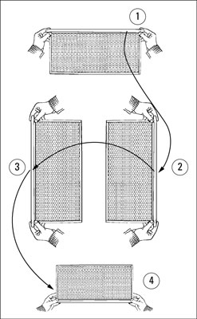
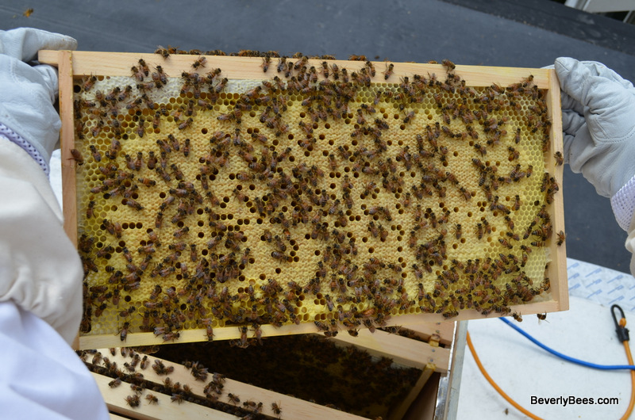
Here’s an easy way to inspect both sides of the frame:
  Hold the frame firmly by the tabs at either end of the top bar.
Turn the frame vertically.
Then turn the frame like a page of a book.
Now smoothly return it to the horizontal position, and you’ll be viewing the opposite side of the frame.
Notes:
Holding up beehive frames for inspection
Holding and inspecting an individual frame the proper way is crucial.
Be sure to stand with your back to the sun, with the light shining over your shoulder and onto the frame.
The sun illuminates details deep in the cells and helps you to better see eggs and small larvae.

Slide 39
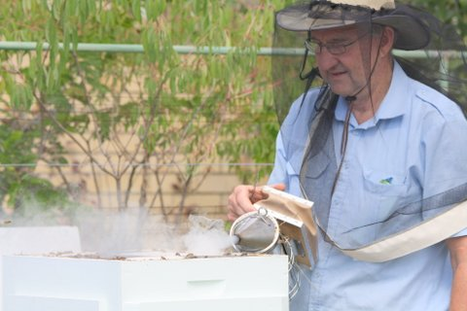
Summary
Knowing when it’s time for more smoke
Understanding what to always look for in your hive
Checking for your queen bee
Storing food and raising the bee brood
Inspecting the brood pattern
Recognizing foodstuffs in your beehive
Notes:
Knowing when it’s time for more smoke
A few minutes into your inspection, you may notice that the bees all have lined up between the top bars like racehorses at the starting gate. Their little heads are all in a row between the frames. Kind of cute, aren’t they? They’re watching you. That’s your signal to give the girls a few more puffs of smoke to disperse them again so that you can continue with your inspection.
Understanding what to always look for in your hive
Each time that you visit your hive, be aware of the things that you always must look for. Virtually all inspections are to determine the health and productivity of the colony. The specifics of what you’re looking for vary somewhat, depending upon the time of year.
Checking for your queen bee
Every time that you visit your hive you’re looking for indications that the queen is alive and well and laying eggs.
Rather than spending time trying to see the queen, look for eggs. Although they’re tiny, finding the eggs is much easier than locating a single queen in a hive of 60,000 bees. Look for eggs on a bright, sunny day.
Storing food and raising the bee brood
Each deep frame of comb contains about 7,000 cells (3,500 on each side). Honeybees use these cells for storing food and raising brood. When you inspect your colony, noting what’s going on in those cells is important because it helps you judge the performance and health of your bees.
Inspecting the brood pattern
Examining brood pattern is an important part of your inspections. A tight, compact brood pattern is indicative of a good, healthy queen. Conversely, a spotty brood pattern (many empty cells with only occasional cells of eggs, larvae, or capped brood) is an indication that you have an old or sick queen and may need to replace her.
Recognizing foodstuffs in your beehive
Learn to identify the different materials collected by your bees and stored in the cells. They’ll pack pollen in some of the cells. Pollen comes in many different colours: orange, yellow, brown, grey, blue, and so on. You’ll also see cells with something “wet” in them. It may be nectar. Or it may be water.

Slide 40
This presentation has been prepared by the
Gold Coast Regional Beekeepers Inc. with information from:
Australian Honey Bee Industry Council (AHBIC)
Wheen Bee Foundation
Department of Agriculture, Fisheries and Forestry ( DAFF Apiary Unit)
Queensland Beekeepers Association (QBA)
Be Aware
Department of Primary Industries NSW (DPI)
Plant Health Australia (PHA)

