Slide 1
The Gold Coast Regional Beekeepers Inc.
Preparing your hives
for
WINTER
Compiled by John Polley

Slide 2
When to inspect and what to look for
Inspect late April or early May at the latest
A sunny day on the warmer side
Did you see the Queen??
Evidence of queen activity, i.e. eggs, grubs or sealed brood
Are there Queen or Drone cells
Is the hive busy

Slide 3
Honey in the hive
How much stored honey is in the hive
A full brood box will need a full super of honey on top for winter in the cooler areas
A weaker brood box will need at least 5 full frames of honey
If feeding Sugar Syrup, 2.5kg of white sugar is equal to 1 frame of honey
Mix Sugar/Water ratio of 2:1, discard after 3 days and replace with a new batch

Slide 4
Comments by Kevin Finn (Beekeeper extraordinaire)
A full brood box requiring a full super of honey would only be in areas where it is cold (like Stanthorpe) and there is little chance of the bees getting out.
Just my opinion, as I have never left a full super of honey on and I have never fed. In areas like Nerang & Bonogin I have already reduced from three boxes down to two with the only exception being a couple of really strong hives.
At Benowa & Ashmore there is generally something coming in all the time and I have left them in three boxes but I have removed surplus honey.
Kevin

Slide 5
Strength of hive
If the bee numbers are reduced, bring the hive back to a single brood box to make it easier for them to control the hive temperature
Ensure that the bees have an adequate store of honey to last them through winter
Reduce the hive entry on weaker hives
Observe the hives regularly through winter to ensure activity

Slide 6
Disease Status
If anything is amiss in your hives or you are unsure what to look for, contact one of our experienced club members or a committee member who will help you out
The four brood diseases you may encounter are; EFB (European Foul Brood) - AFB (American Foul Brood) - Sacbrood and Chalkbrood
And of course our old friend the Small Hive Beetle (SHB)

Slide 7
Disease | Symptoms
European foulbrood | twisted around cell wall white through to discoloured yellow to dark brown watery, granular larvae occasionally ropey
American foulbrood | discoloured through to dark brown unsealed or with perforated sunken discoloured capping's ropey larvae hard to remove scales
Chalkbrood | white and mouldy hard larvae white or grey/black mummies in cells on the floor,
Sacbrood | discoloured yellow through to black, gondola shaped in capped cells or under perforated caps, easily removed

Slide 8
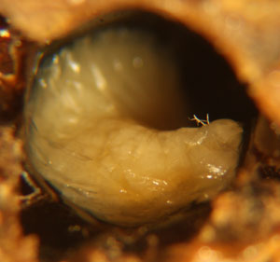
A classic symptom of European foulbrood is a curled upwards, flaccid, and brown or yellowish dead larva in it's cell, pictured above.

Slide 9
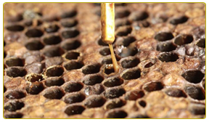
Close up comb showing symptoms of American Foul Brood (AFB)
Dark sunken capping
Perforated cell caps

Slide 10
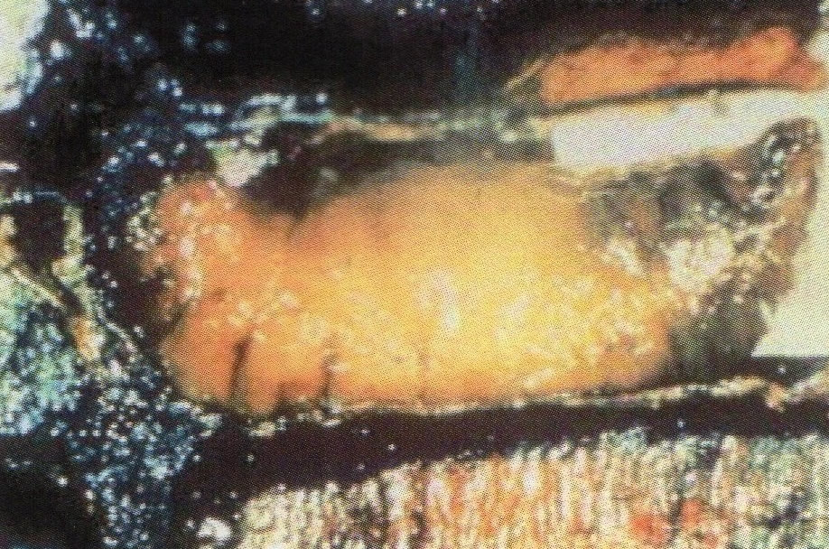
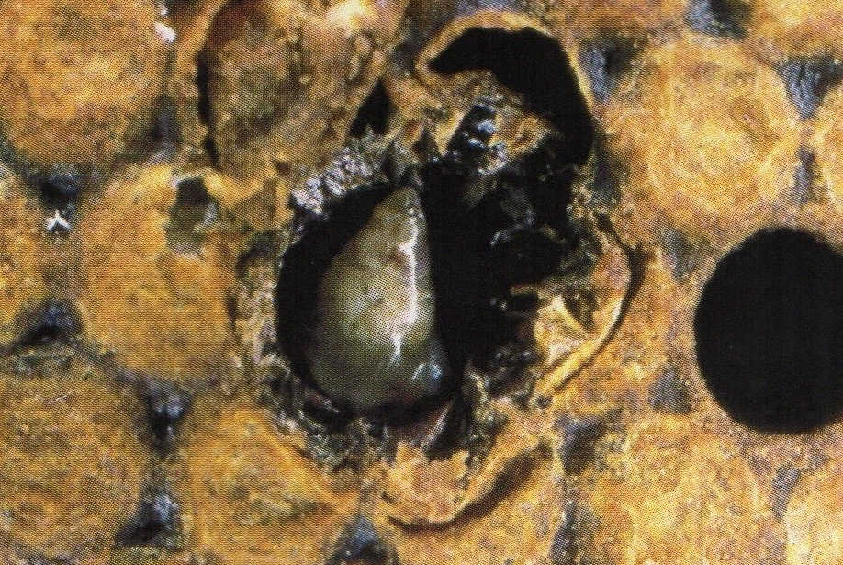
Sac Brood The pupae do not develop or shed the last skin which locks in the pupae as it rots containing the spores. The brood is pointing downwards but that is because the head does not develop:

Slide 11
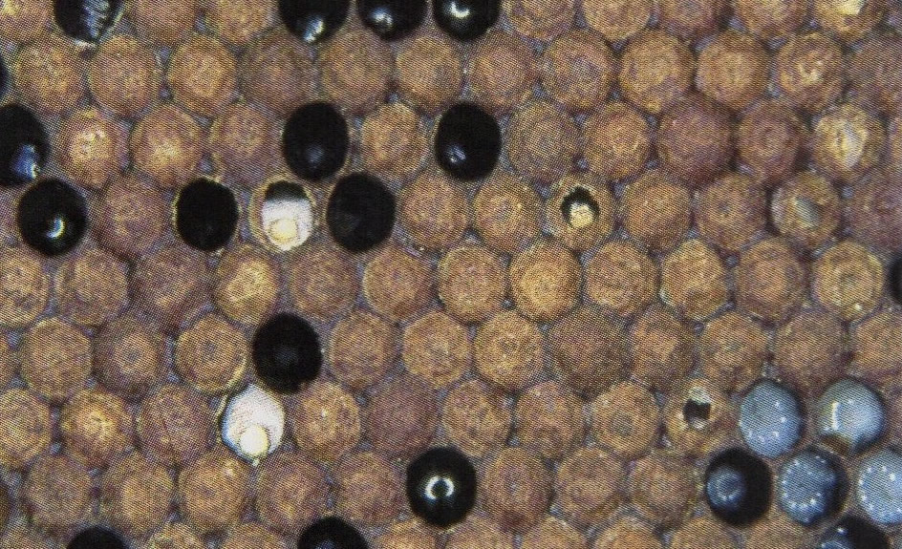
Chalkbrood. Chalkbrood is caused by the fungus Ascosphaera appis and it affects both sealed and unsealed brood.

Slide 12
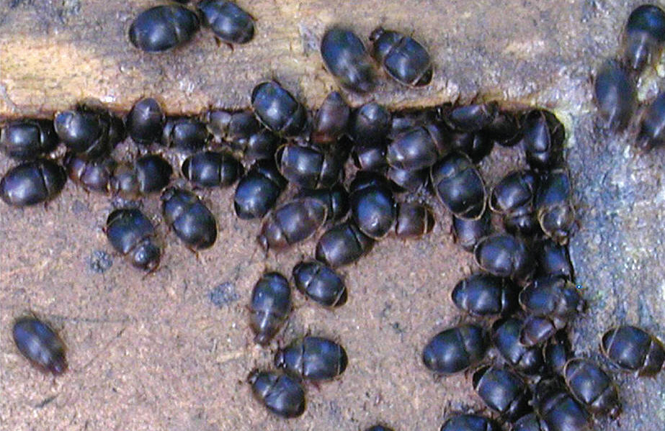
Small Hive Beetle
These amazing little creatures can………

Slide 13
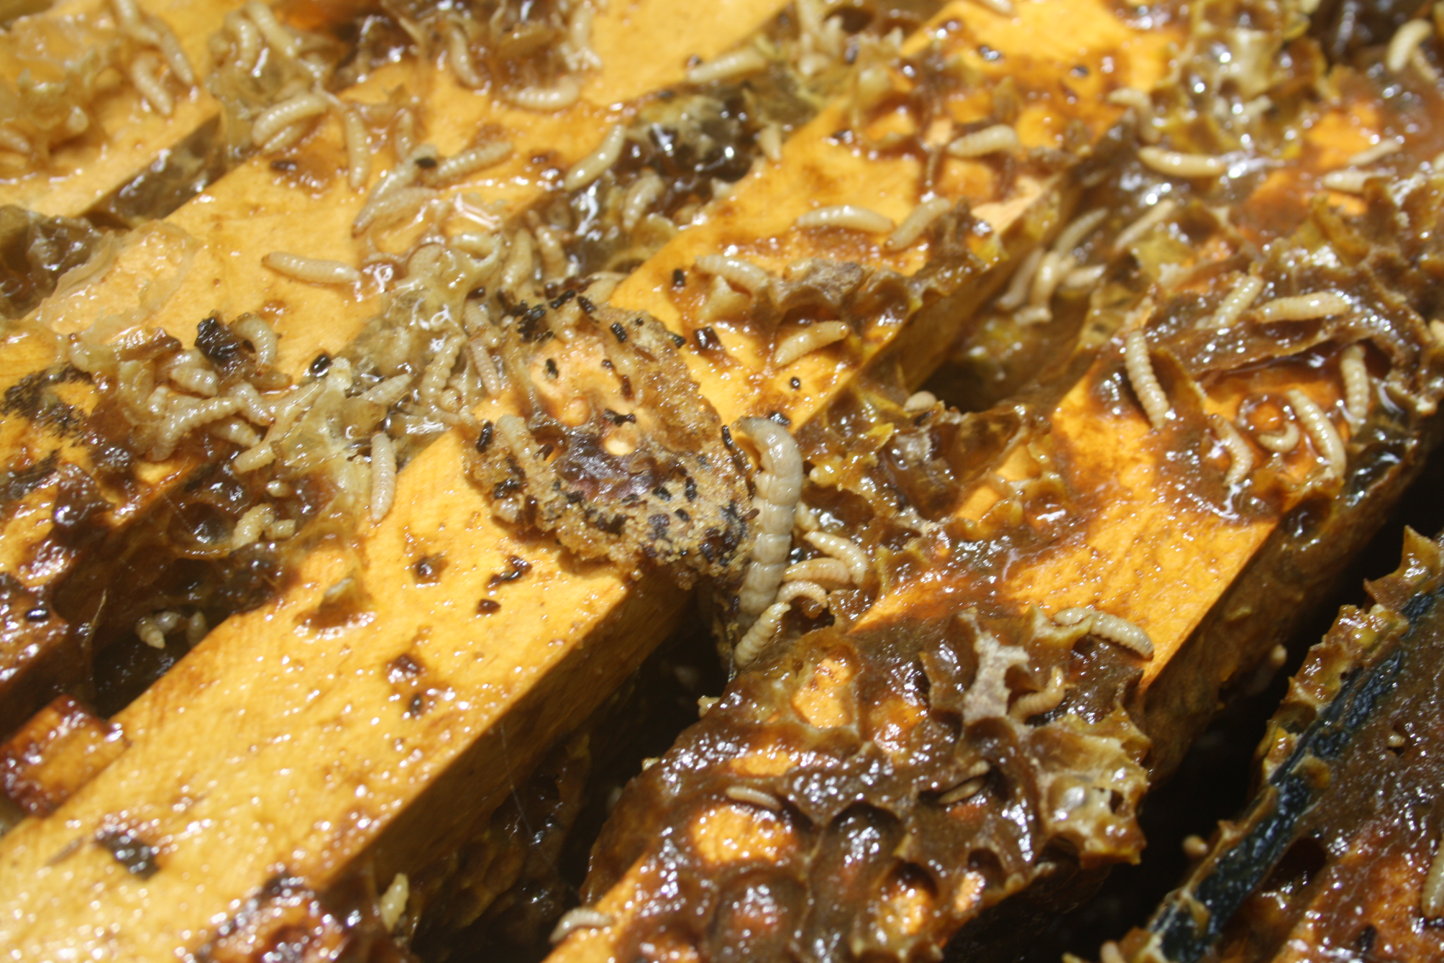
………..do this to a hive that swarmed 4 days prior

Slide 14
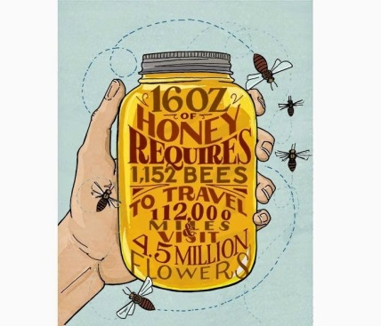
During Winter
Pop down and say G’day to your girls each weekend
Check external SHB traps (now you know why it was better to spend the extra dollars on the bottom board with built in SHB traps)
Observe to comings and goings of the bees, are they busy on a warm day, are they bringing in pollen

