Slide 1
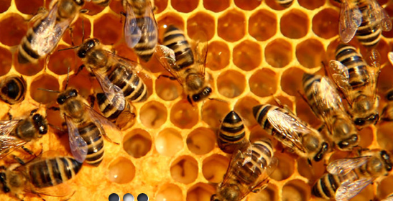
Gold Coast Regional Beekeepers Inc.
Introduction To Beekeeping
www.gcrbs.org.au
Prepared by John Polley
Notes:
Welcome to the Gold Coast Regional Beekeepers Inc.'s Feel free to talk to any of our members and ask any questions that you may have regarding bees, beekeeping and pollination.
Some of our members are not as agile as they once were, but the knowledge they have about beekeeping would fill many a book, so please take advantage of their knowledge and experience take your first steps towards becoming a beekeeper.

Slide 2
Overview
Types of bees
Developments of bees
lifecycle of bees
Bees communication and food sources
Bee safety
Bee equipment
Starting out
Starter kits – GCABS
Good bee keeping practices

Slide 3
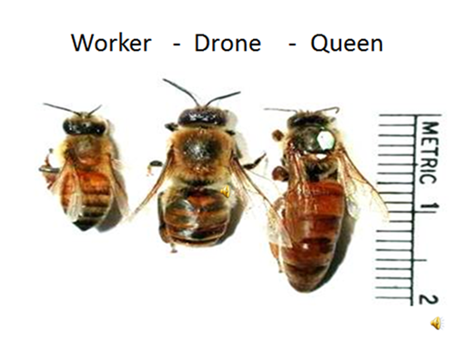
The 3 castes of honey bees
Worker - (98% - 99% of hive population).
a non-reproductive female bee. Workers collect nectar, pollen, water and propolis, rear brood and carry out many other activities
Drone –( 1%-2% of hive population). The male bee. It is large, has a square-ended body, very large eyes and NO sting
Queen – (1 per Hive)
The only reproductive female in the colony and mother to all bees in the hive. There is usually only one queen per hive.
Notes:
First we will start with the very basics, the 3 castes of bees. The queen who will lay between 1500 and 2000 eggs per day, has one mating flight where she will mate with between 15 to 20 drones during this flight. The Drones all die after mating.
The Drone, his only purpose in life is to mate with a queen bee. Drones do no work in the hive what so ever and only fly to mating sites where they will orbit at between 150 and 60 metres above the ground waiting for queens to arrive, they mate mid- air and the drone then tumbles to the earth to die.
The Worker, she does it all, cleans, builds the comb, raises the young, guards the hive and forages for nectar, pollen and propolis. Then in her spare time……

Slide 4
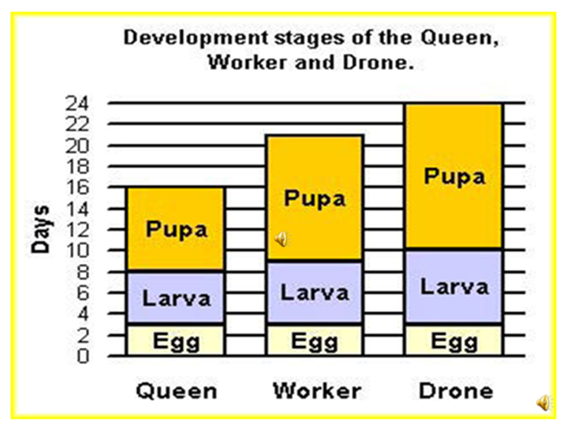
Development stages of the different caste
Notes:
The larval and pupa stages of an insect's development are consecutive but very different. The larva is generally a worm-like creature that emerges from the egg, the first life stage. The pupa is the seemingly sedentary, transformative form following the larval stage. Going through both stages to reach adulthood is defined as complete metamorphosis in insects.

Slide 5
Lifespans of the worker
Notes:
Queen bees may live for 3 – 5 years, during that time she will never leave the hive, that lifestyle may only be interrupted by an occasional swarm. We didn’t feel that showing the lifespan of a drone would be very appropriate.

Slide 6
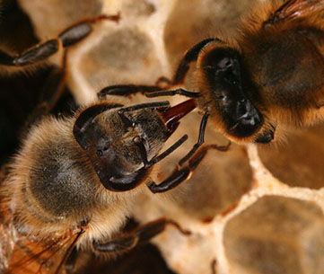
Nurse bee feeding young brood
Notes:
1 – 2 Days cleans cells and warm the brood nest
Nursing young worker bees (days 4 to 12)
The young worker bees tend to their “baby sisters” by feeding and caring for the developing larvae. On average, nurse bees check a single larva 1,300 times a day.
Attending to the queen bee (days 7 to 12)
Because her royal highness is unable to tend to her most basic needs by herself, some of the workers do these tasks for her.

Slide 7
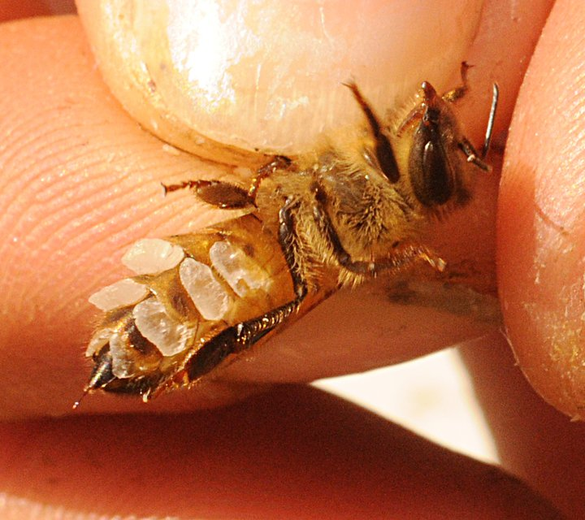
How Bee’s make Wax
Notes:
When honey bees are between 12 and 20 days old, they develop a special wax-producing gland in the abdomen of their bodies. This special gland converts sugar from the honey into a waxy substance and deposits flakes of the substance on the abdomen.
These small flakes of wax are collected by the other bees and chewed in their mouths. The bees then add these pieces of wax to a wax foundation provided by the beekeeper as a starter to assist in the comb construction. In the wild, the bees start from scratch.
Beekeepers often use the expression that ‘the wax is drawn’ or ‘drawn out’, this means that the bees have used the flat foundation wax provided by the beekeeper and made it thicker – turning it into the well known hexagonal comb cells which are used for storing honey or egg laying.
Bees keep the inside of the hive at a constant temperature which makes the wax easy to manipulate and the right consistency to allow the bees to build. If the hive gets too hot the wax drips and if it gets too cold it becomes brittle.
It has been estimated that it takes 2.72kg (6lb) of honey to make 0.45kg (1lb) of wax.

Slide 8
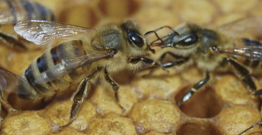
Receiving food from a forager

Slide 9
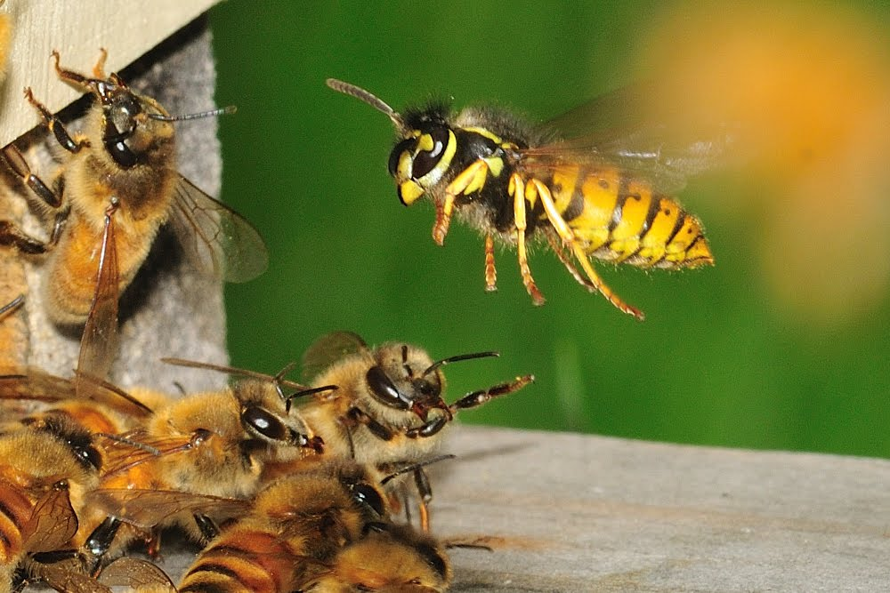
Guard bees defending the hive against attack
Notes:
All honey bees live in colonies where the workers sting intruders as a form of defence, and alarmed bees release a pheromone that stimulates the attack response in other bees.

Slide 10
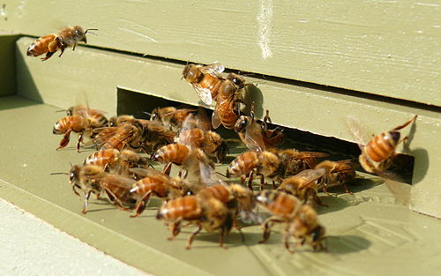
Bees Fanning at the hive entrance
Head down, Bum up, Wings going flat chat creating air movement throughout the hive
Notes:
Bees cluster on the outside of the hive during the heat of the day. Sometimes called “wash boarding,” the bees move outside to cool down the interior of the hive. If you watch their behaviour closely, you will see the bees fanning their wings.

Slide 11
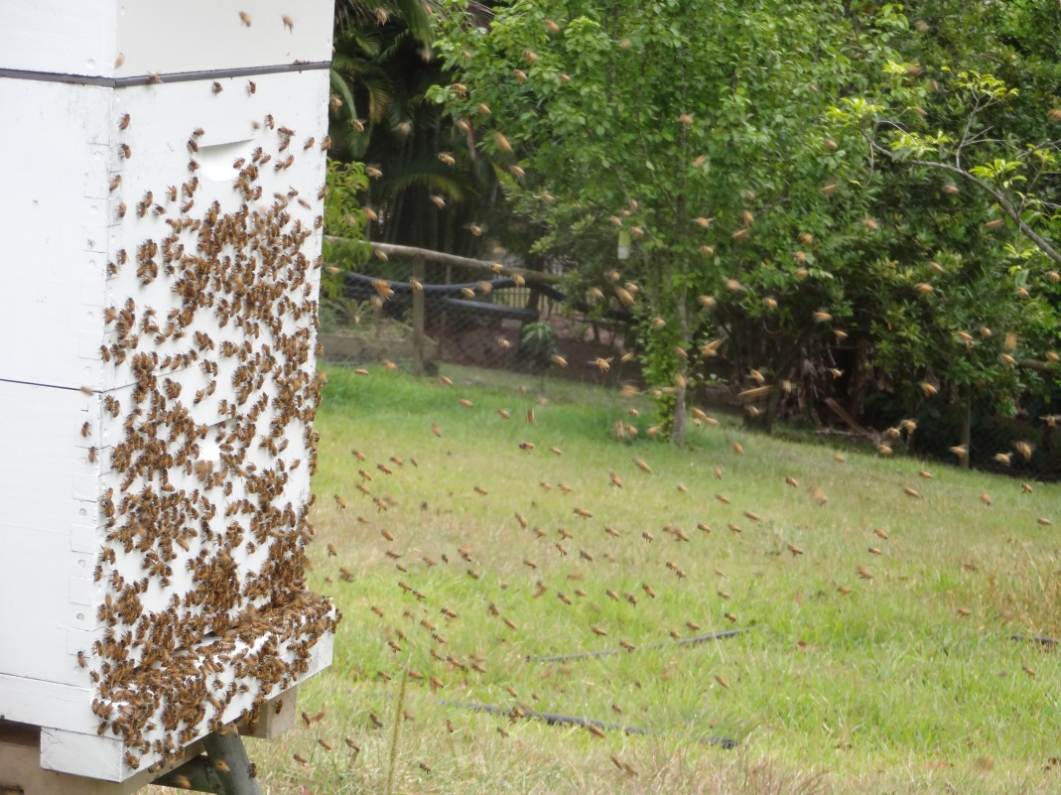
Orientation flights
Orientation flights
Young bees walk out of the hive, fly a short distance in front, turn by 180 degrees so that they are facing the hive, then hover back and forth in arcs. After a few moments the orientation flight becomes characterised by the ever increasing circles around and above the hive and after a few minutes the bee returns to its hive without carrying any pollen or nectar
Orientation flights
Age related tasks of honey bees culminate in foraging, this being the final group of tasks they perform before death. Although the starting age for foraging is variable, it commonly peaks in bees over 20 days of age.
Notes:
At this point the bees that were mainly nest bound leave the colony to collect nectar, pollen, water and propolis so therefore need to familiarise themselves with the landscape and landmarks outside the nest and the position of the nest entrance. They do so by taking orientation flights in the days preceding their first foraging flights. Young bees walk out of the hive, fly a short distance in front, turn by 180 degrees so that they are facing the hive, then hover back and forth in arcs. After a few moments the orientation flight becomes characterised by the ever increasing circles around and above the hive and after a few minutes the bee returns to its hive without carrying any pollen or nectar). The orientation flights tend to take place on warm windless afternoons. Interestingly, on these flights, ‘foragers to be’ take the opportunity to void their faeces, as they had not had a chance to cleanse previously.
It is commonly believed that young bees do this together and the orientation flights are often seen as a sudden increase in activity on warm sunny afternoons, whether the young bees have an instinct to orientate in groups seems to remain unclear.

Slide 12
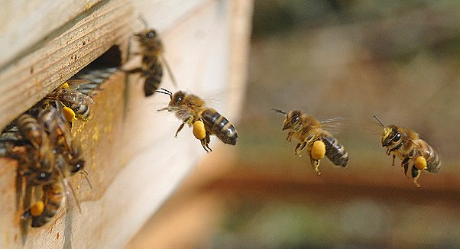
Worker bees returning from foraging
The Life of a Worker Bee
Notes:
22 + Forage for nectar, pollen, propolis and water

Slide 13
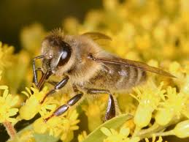
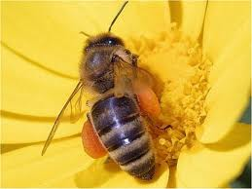
Collecting Nectar and Pollen for the hive
Notes:
Nectar, a liquid high in sucrose, is produced in plant glands known as nectaries. It is an important energy resource for honey bees and plays a significant role in foraging economics and evolutionary differentiation between different subspecies.
Bees collect pollen in the pollen basket and carry it back to the hive. In the hive, pollen is used as a protein source necessary during brood-rearing. In certain environments, excess pollen can be collected from the hives of A. mellifera and A. cerana. It is often eaten as a health supplement.
Propolis or bee glue is created from resins, balsams, and tree saps. Those species of honey bees that nest in tree cavities use propolis to seal cracks in the hive. Propolis is consumed by humans as a health supplement in various ways and also used in some cosmetics.

Slide 14
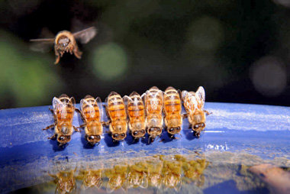
Foraging bees collecting water for hive
Notes:
Water has several uses in a honey bee hive. During certain times of the year foragers find a source of water, fill their crops, and ferry it home. The number of bees foraging for water depends on the needs of the colony. If the in-hive workers accept the water quickly from the foragers, the foraging bees sense that the need is still high, and they will go back for another load. If the in-hive workers are slow about “unloading” the water, the foragers sense that the need for water has lessened and fewer bees will return for more.
Bees find water in a number of places including damp rocks, branches, muddy puddles, pond edges, and drops adhering to vegetation. They swallow the water and store it in their crops before flying home. The water is transferred to the waiting in-hive workers through the process of trophallaxis—the direct transfer from one bee to another.

Slide 15
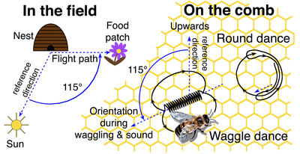
How do Bees communicate where they found the food source ??
Notes:
The dance language is used by one individual to communicate two items of information to one ore more receivers: the distance and direction to a location (typically a food source, such as a patch of flowers). It is usually used when an experienced forager returns to her colony with a load of food, either nectar or pollen. If the quality of the food is sufficiently high, she will often perform a "dance" on the surface of the wax comb to recruit new foragers to the resource. The dance language is also used to recruit scout bees to a new nest site during the process of reproductive fission, or swarming. Recruits follow the dancing bee to obtain the information it contains, and then exit the hive to the location of interest. The distance and direction information contained in the dance are representations of the source's location

Slide 16
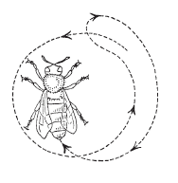
Components of the dance language
At its core, there are two things communicated in a dance: distance and direction.
These two pieces of information are translated into separate components of the dance.
The 2 most common dances are the Round Dance and the Wag Tail Dance
The Round Dance
Notes:
When a food source is very close to the hive (i.e., less than 50 meters away), a forager performs a round dance She does so by running around in narrow circles, suddenly reversing direction to her original course. She may repeat the dance several times at the same location or move to another location to repeat the dance. After the round dance has ended, she often distributes food to the bees following her. A round dance, therefore, communicates distance ("close to the hive"), but no direction.

Slide 17
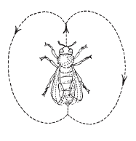
The Tail Wag Dance
Notes:
A bee that performs a waggle dance runs straight ahead for a short distance, returns in a semicircle to the starting point, runs again through the straight course, then makes a semicircle in the opposite direction to complete a full, figure-eight circuit. While running the straight-line course of the dance, the bee's body, especially the abdomen, wags vigorously sideways. This vibration of the body gives a tail-wagging motion. At the same time, the bee emits a train of buzzing sound at a low frequency of 250-300 Hertz (cycles per second) with a pulse duration of about 20 milliseconds and a repetition of frequency of ca 30 seconds. The sound is produced by wingbeats.
While several variables of the waggle dance are correlated with distance information (e.g., dance "tempo", duration of buzzing sounds), the duration of the straight run portion of the dance, measured in seconds, is the simplest and most reliable indicator of distance. As the distance to the food source increases, the duration of the waggling portion of the dance (the "waggle run") also increases. The relationship is roughly linear, as shown in the figure. For example, a forager that performs a waggle run that lasts 2.5 seconds is recruiting for a food source located approximately 2625 meters away.

Slide 18
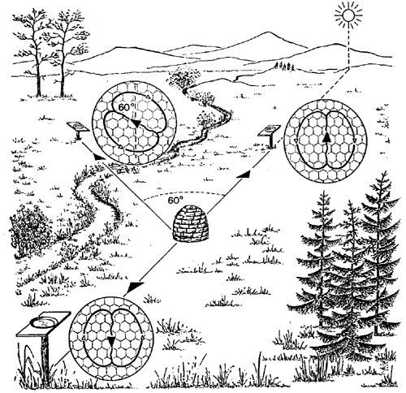
Source 60* left of sun
Source directly towards the sun
HIVE
LOCATION
Source directly away from the sun
Direction
While the representation of distance in the waggle dance is relatively straight-forward, the method of communicating direction is more complicated and abstract. The orientation of the dancing bee during the straight portion of her waggle dance indicates the location of the food source relative to the sun. The angle that the bee adopts, relative to vertical, represents the angle to the flowers relative to the direction of the sun outside of the hive. In other words, the dancing bee transposes the solar angle into the gravitational angle. The figure below gives three examples. A forager recruiting to a food source in the same direction as the sun will perform a dance with the waggle run portion directly up on the comb. Conversely, if the food source were located directly away from the sun, the straight run would be directed vertically down. If the food source were 60 degrees to the left of the sun, the waggle run would be 60 degrees to the left of vertical.
Because the direction information is relative to the sun's position, not the compass direction, a forager's dance for a particular resource will change over time. This is because the sun's position moves over the course of a day. For example, a food source located due east will have foragers dance approximately straight up in the morning (because the sun rises in the east), but will have foragers dance approximately straight down in the late afternoon (because the sun sets in the west). Thus the time of day (or, more importantly, the location of the sun) is an important variable to interpret the direction information in the dance.
The sun's position is also a function of one's geographic location and the time of year. The sun will always move from east to west over the course of the day. However, above the tropic of cancer, the sun will always be in the south, whereas below the tropic of Capricorn, the sun will always be in the north. Within the tropics, the sun can pass to the south or to the north, depending on the time of year.
In summary, in order to translate the direction information contained in the honey bee dance language, one must know the angle of the waggle run (with respect to gravity) and the compass direction of the sun (which depends on location, date, and time of day).

Slide 19
Starting Out
Carry out research into the keeping of bees, to see what is involved with the management of bee hives.
Join a local beekeepers (apiary) club and talk to people who have been involved in beekeeping for many years. Decide if beekeeping is for you.
As a member of a bee club, you can join experienced members opening and inspecting hives as well as extracting honey. This enables you to get some prior knowledge and experience before buying your own hives and equipment. Decide whether you will start beekeeping by buying all of the necessary supers, frames, bottom boards, excluders, lids etc. and building your own hive, an existing hive from a club member or starting with a nucleus hive from a breeder or club member. For your first hive it is often easier to buy an existing, productive hive and grow from there. To keep bees in Queensland you must first register with the Dept. Agriculture, Fisheries and Forestry (DAFF), and obtain your Registered Brand Number. In NSW this is done through DPI. This registration is to be renewed yearly. Now you are ready to get your own bees. Use the knowledge of experienced members when you choose your equipment. New, second hand, or built by you. It is your choice, but don’t buy 2nd hand equipment unless you have them inspected to make sure they are not been infested by a foul brood. Helping new members is one of the prime functions of the club.

Slide 20
Beekeepers Starter Kit
A list of Basic requirements that a beginner will need to start beekeeping
The hive body consists of the following parts;
Bottom Board complete with 2 slide out Small Hive Beetle (SHB) traps
2 x 10 frame Supers (wooden boxes) 1 for the Brood Box and 1 for Honey collection
1 x complete migratory Lid
20 x Frames (Full Depth)
20 x Sheets of Full Depth Foundation (was sheets to fit in the frames)
1 x 600g roll of wire, (threaded through the frame to support the foundation.)
1 x bag 500 Brass eyelets, (to prevent frame wire from digging into frame timber)
1 x Emlock and metal strap, ( to secure the hive supers and lid.)
1 x Spur wheel Embedder, (to embed the frame wire into the foundation.)
1 x Embedding board, (to support the foundation while wire is embedded.)
1 x 500g pack 65mm x 1.4mm Flat Head Nails
1 x 500g pack 30mm x 1.5mm Flat Head Nails
1 x 250g pack 25mm x 1.4mm Flat Head Nails

Slide 21
Protective Clothing;
1 x Brimmed Hat with Veil Or
Bee Jacket with hooded veil
Full Bee suit with hooded veil
Overalls / Disposable Tyvak overalls w/hat and veil
1 x Pair sturdy long sleeved gloves
Boots/Shoes
Basic Tools;
1 x Smoker 4” Stainless Steel
1 x Bee Brush
1 x Hive Tool
1 x 20 litre plastic pail and lid
This equipment is available in flat pack from the Gold Coast Amateur Beekeepers Society’s equipment officer at Club prices.

Slide 22
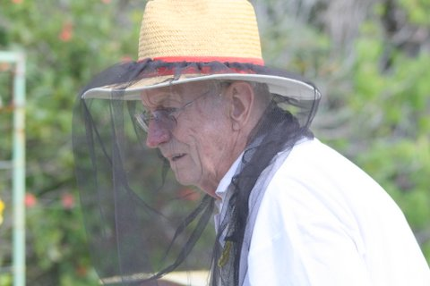
General Safety Precautions and Protection
Always wear protective clothing that is light and of smooth texture as bees will react unfavourably to dark or woolly materials
The Beekeepers hat should have a wide brim to support the veil and keep it away from the face. Straw hats, complete with veils are available from equipment officers.
Avoid wearing scented lotions, perfumes, etc. while near hives.
Notes:
Note that wide brim straw hats keep the veil well clear of the face

Slide 23
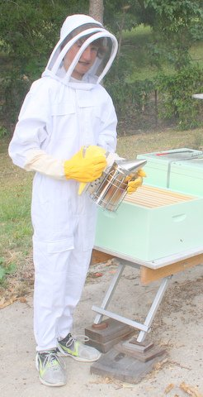
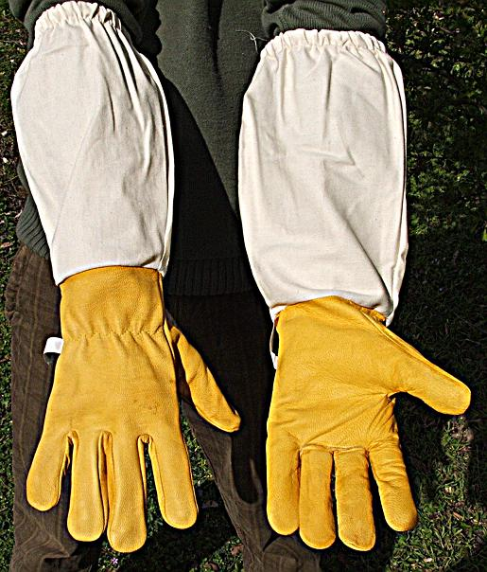
Body protection can be achieved with a full protective apiary suite complete with helmet, cotton coveralls fitted with elastic cuffs and wrist bands or Tyvek disposable overalls that come complete with a hood. Thick light coloured socks are also advisable to be worn with work boots and ankle covers, many experienced beekeepers do not wear veils or gloves by preference
Full protective suit
Long sleeved gloves
A pair of long sleeved beekeeping cloves that allow easy movement of the fingers when lifting frames
Notes:
Many experienced beekeepers do not wear veils or gloves by preference

Slide 24
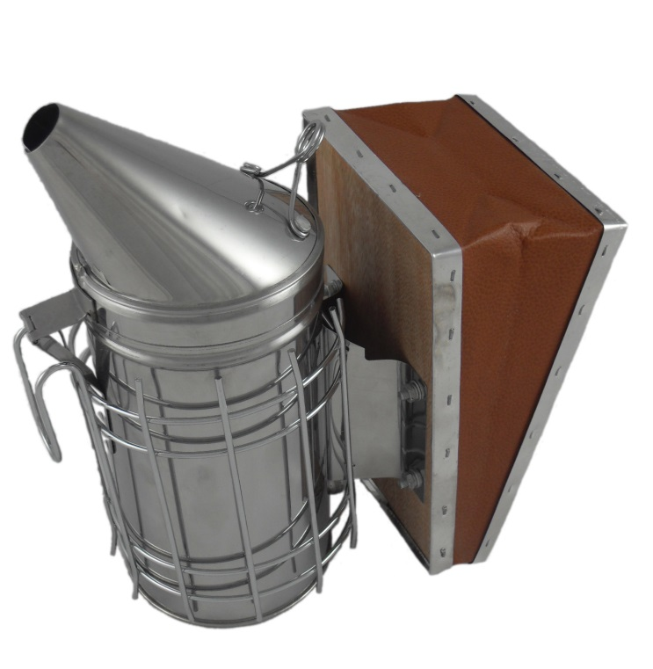
Beekeeping Tools
The two most essential tools used by beekeepers are the Smoker and the hive tool.
Hive tool
Smoker
Notes:
The two most essential of tools, in an emergency a flat nosed screwdriver will substitute for a Hive tool, but a good smoker is essential

Slide 25
The Smoker.
It is best to buy a smoker that has a barrel of approximately 100mm.
This size smoker will provide an ideal amount of cool smoke to subdue the bees before opening the hive and during the time it is open.
Always have your smoker well alight and producing large volumes of COOL smoke before entering your apiary.
Take care not to burn yourself or set fire to the grass around where you are working. Beekeepers use a variety of materials in the smoker to provide the cool smoke, items such as sugar cane mulch, tea tree bark, old leaves from pine trees or gum trees, small twigs or dead grass. Once they have found a favourite fuel, most beekeepers will stick to it as they know how long it will burn and the quality of smoke generated
Notes:
Learning to fire up a smoke is a personal trait, some beekeepers use pine or gum leafs, some prefer paper bark, while yet again others will use dried grass or sugar cane mulch. You don’t want a raging fire in your smoker just a gentle cool smoke.

Slide 26
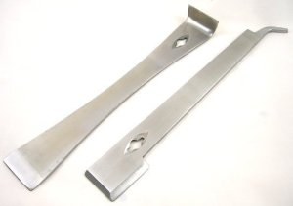
The Hive Tool
This tool is used to separate the boxes when opening the hive and to separate and lift the frames which hold the combs
Australian hive tool
USA hive tool
Notes:
Hive tools come in a variety of sizes and shapes, and again it is a personal preference.

Slide 27
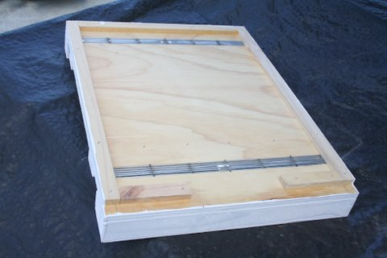
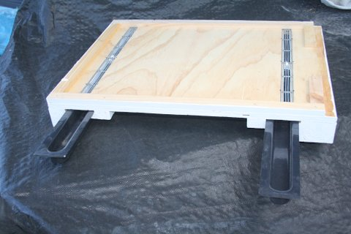
Bee hive components - Bottom Board
Should be painted
Bottom Board with Small Hive Beetle (SHB) traps
SHB grid
SHB
oil traps
Should be painted
Notes:
When painting multiple components ALWAYS check that you have done BOTH sides before putting your brush or roller away

Slide 28
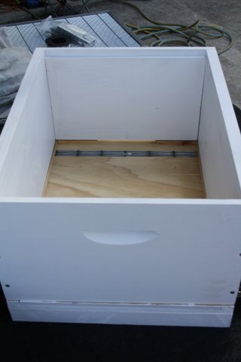
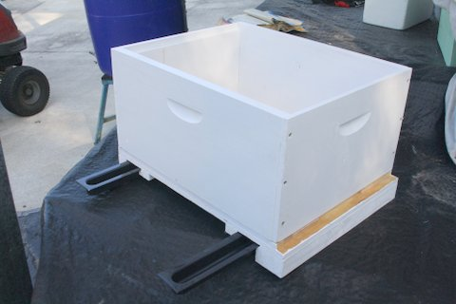
Bee hive components -
Brood Box fitted onto Bottom Board
Brood Box - the bottom box of a hive, which usually contains the brood of the colony, also called a brood chamber
Entry
Bottom Board – The base of the hive that allows the bees entry to the hive

Slide 29
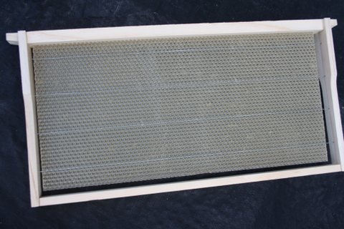
Bee hive components -
Completed frame wired and foundation fixed
Wax Foundation
Frame
Wire
Brass eyelets
Frame – A wooden or plastic frame used to contain combs – fits into both brood and honey boxes

Slide 30
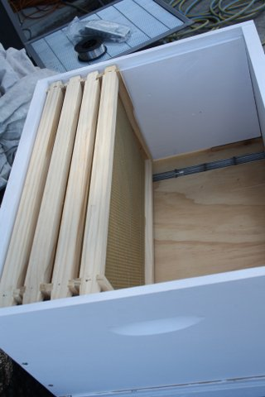
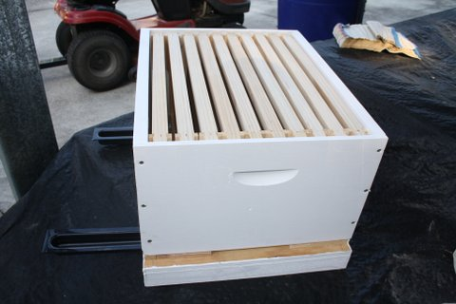
Bee hive components -
completed frames being placed into brood box
10 frames in a brood box
Brood Box
Bottom Board
Many apiarist prefer to run only 9 frames in the brood box to lessen the chance of damaging the queen during inspections and in honey supers so the bees are able to build out the comb further which in turns makes for easier uncapping.
Notes:
Most apiarist run 9 frames in both the brood box and honey super to allow for more “Bee Space”

Slide 31
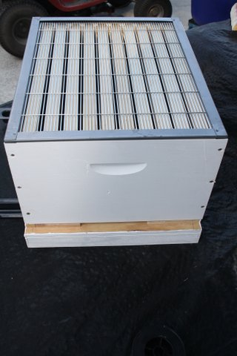
Bee hive components -
Queen excluder in place above brood box
Queen excluder
Queen Excluder
A perforated sheet of zinc, or plastic, or a wire screen placed between the brood chamber and super to prevent the queen having access to the super whilst allowing workers free access

Slide 32
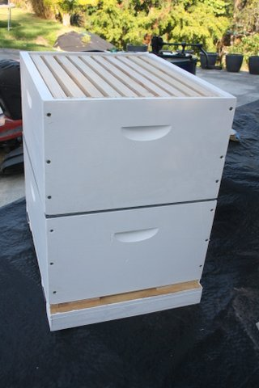
Bee hive components -
Honey super (box) with 9 frames above brood box
Honey Super
The top box above the queen excluder where the bees store capped honey
Honey Super –
9 Frames
Queen Excluder
Prevents the Queen and drone from going higher in the hive
Queen excluder
Brood Box
Brood Box
Where the queen lays eggs, the brood are raised and honey and pollen are stored to feed the brood
Bottom board
Bottom Board
Allows worker bees access to the hive and often contains SHB traps

Slide 33
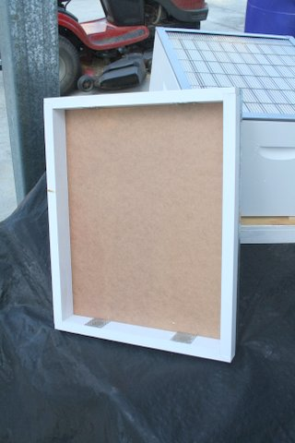
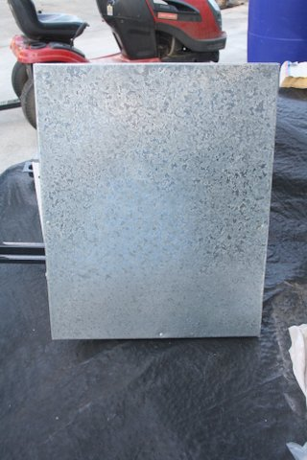
Bee hive components -
Lid with vents
Vents
The inside of the lid should also be painted
Notes:
Vents may be fixed to either the inner or outer side of the box

Slide 34
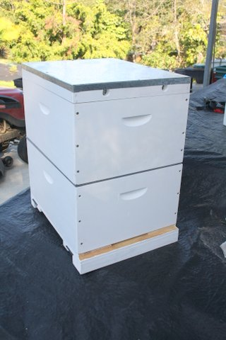
Bee hive components -
Assembled hive
Completed Hive
Hive _ a man made domicile or container in which a colony of bees has been established.
Notes:
All the hive needs is your registration number and bees and you are away

Slide 35
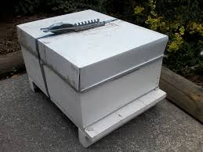
Hive secured using Emlock
Adjustable Emlock strap for securing hive
Notes:
Emlocks provide security for hives to prevent the hive from breaking apart if bumped or tipped over and whilst being transported

Slide 36
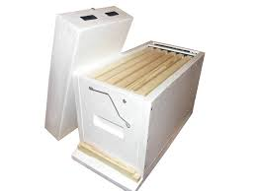
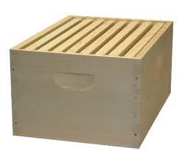
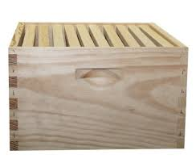
Types of Langstroth hive boxes
Nucleus hive box
Holds 5 frames and is used to form a new colony
8 frame hive box
Lighter, smaller and easier for older apiarist
Standard 10 frame box
Can weigh 35kg to 40kg when full

Slide 37
Construction of hives
Good beekeeping practices include regular inspections of brood and honey combs in all hives for honey bee diseases and pests.
Proper inspections are impossible when hives do not have beeswax combs held within removeable frames.
The Code requires beekeepers to only keep hives that have easily and individually removable frames.
In cases where hives don't contain moveable frames, the Code empowers apiary inspectors to order beekeepers to transfer the combs to moveable frames or destroy the bees.
The Act does not stipulate dimensions for hives and frames. However, almost all beekeepers use the 8- or 10-frame
Langstroth full-depth hive.

Slide 38
This presentation has been prepared by the Gold Coast Regional Beekeepers Inc. with assistance from:
Australian Honey Bee Industry Council (AHBIC)
Wheen Bee Foundation
Department of Agriculture, Fisheries and Forestry (DAFF Apiary Unit)
Queensland Beekeepers Association (QBA)
Be Aware
Department of Primary Industries NSW (DPI)
Plant Health Australia assistance from: (PHA)

