Slide 1
Gold Coast Regional Beekeepers Inc.
Small Hive Beetle
Compiled by John Polley

Slide 2
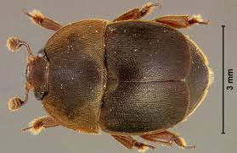
Small hive beetle The small hive beetle is a beekeeping pest. Endemic to sub-Saharan Africa, the small hive beetle, Aethina tumida was first discovered in the United States in 1996 and has now spread to the Australian East Coast following its discovery in New South Wales in 2002

Slide 3
The small hive beetle is a member of the family of scavengers or sap beetles. The adult beetle is dark brown to black and about 3 – 5 mm in length. The adults may live up to 6 months and can be observed almost anywhere in a hive, although they are most often found on the rear portion of the bottom board of a hive. Female beetles lay irregular masses of eggs in cracks or crevices in a hive. The eggs hatch in 2–3 days into white-coloured larvae that will grow to 5 mm in length. Larvae feed on Pollen and Honey , damaging combs, and require about 10–16 days to mature. Larvae that are ready to pupate leave the hive and burrow into soil near the hive. The pupation period may last approximately 3–4 weeks. Newly emerged adults seek out hives and females generally mate and begin egg laying about a week after emergence. Hive beetles may have 4–5 generations a year during the warmer seasons.
The primary damage to colonies and stored honey caused by the small hive beetle is through the feeding activity of the larvae. Hives and stored equipment with heavy infestations of beetles have been described as a mess. A summary taken from various reports of damage caused by these beetles is listed below:
Larvae tunnel through comb with stored honey or pollen, damaging or destroying capping's and comb. Larvae defecate in honey and the honey becomes discoloured from the faeces. Activity of the larvae causes fermentation and a frothiness in the honey; the honey develops a characteristic odour of decaying oranges. Damage and fermentation cause honey to run out of combs, creating a mess in hives or extracting rooms. Heavy infestations cause bees to abscond; some beekeepers have reported the rapid collapse of even strong colonies. The beetle is most often found in weak or failing hives and rarely affects strong hives.

Slide 4
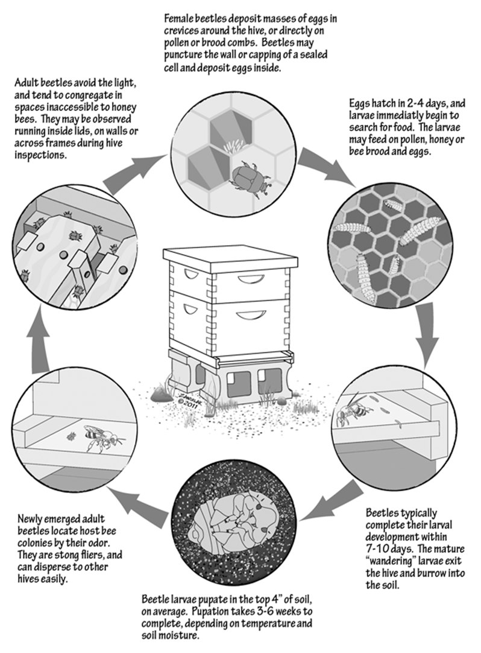
The Life
Cycle
Of the
Small Hive Beetle

Slide 5
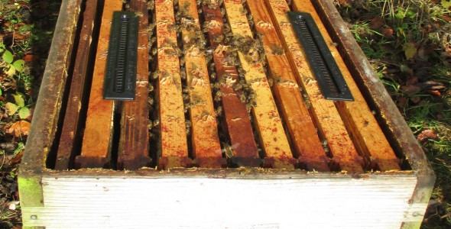
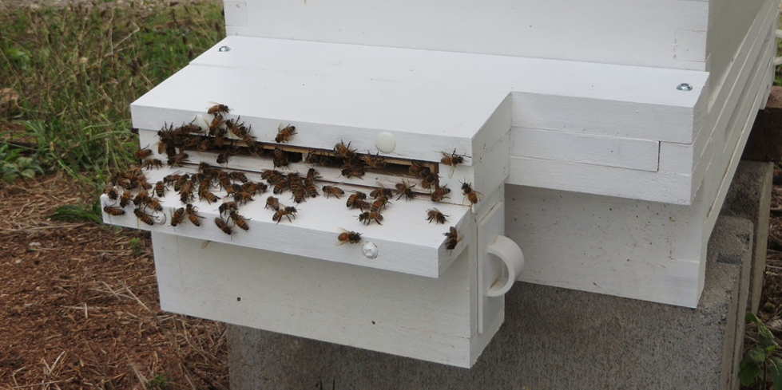
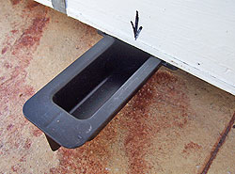
The most effective control against small hive beetle is maintaining colony strength. Coupled with minimizing empty frames of comb, this will all but eliminate the chances of colony failure.
There are also several traps currently on the market. The more effective ones are the Beetlejail Baitable, Hood Trap, the Freeman Beetle Trap, the West trap, the Australian, AJ's Beetle Eater^{[5]} and the Beetle Blaster.^{[6]} All these traps use non-toxic oil to suffocate the beetles. This allows beekeepers to avoid having toxic chemicals in their beehives.

Slide 6
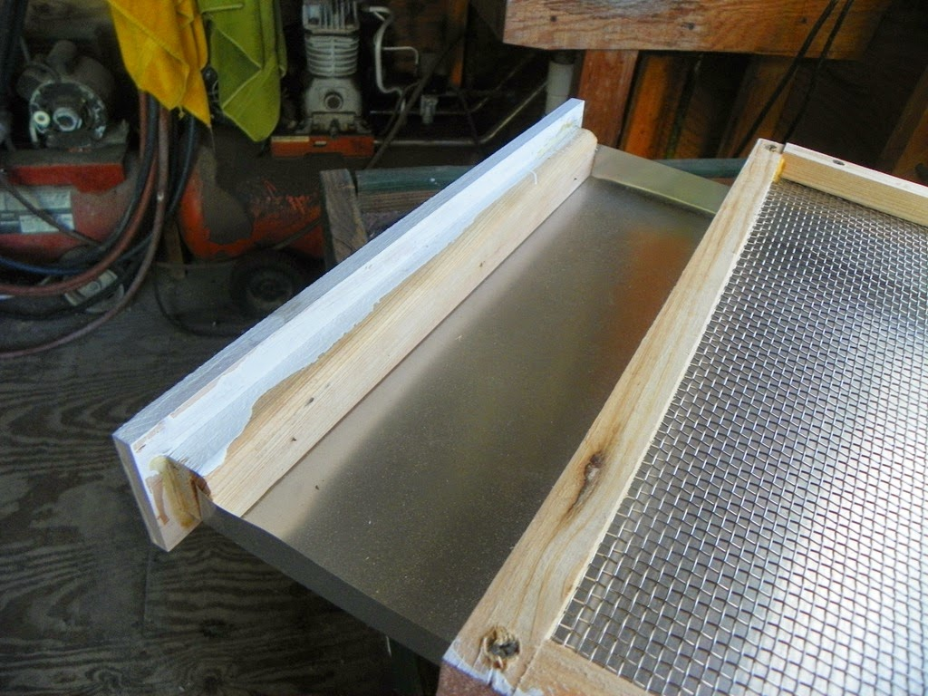
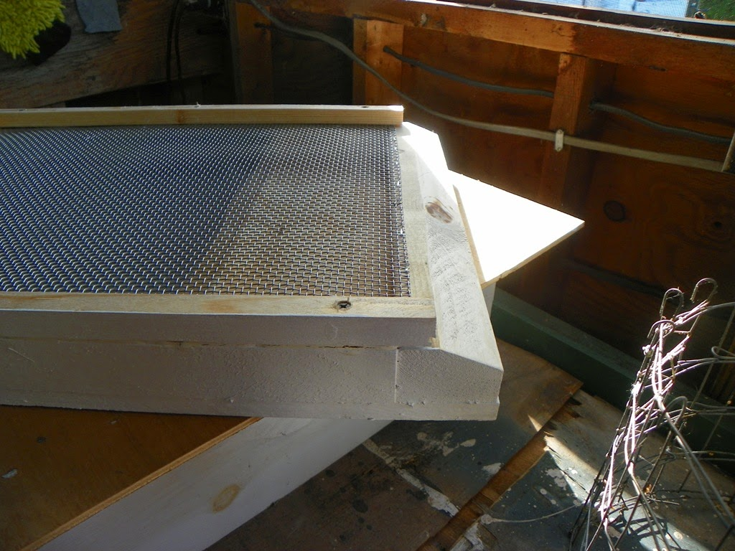
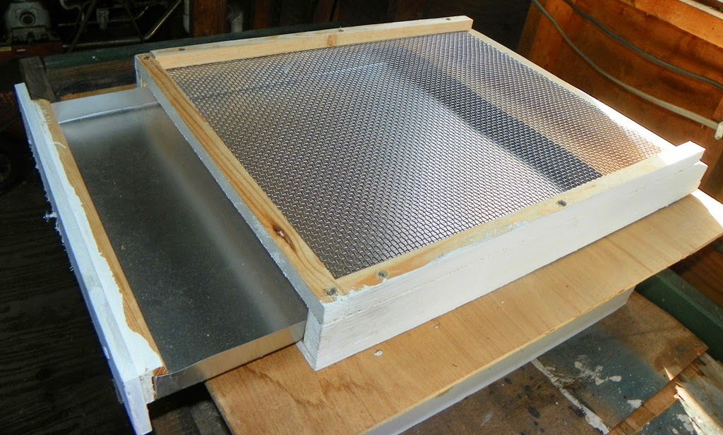

Slide 7
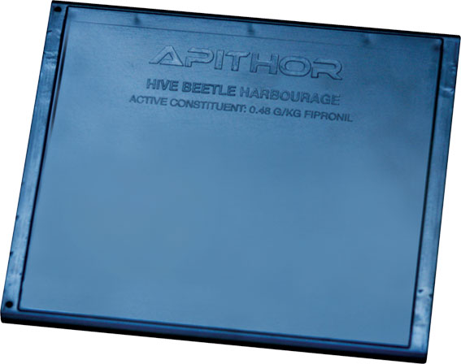
To coincide with the launch of Apithor, RIRDC today has also released a new report aimed at improving our understanding and management of the SHB. Small Hive Beetle Biology – Producing control options looked at the biology and behaviour of the SHB and the environmental factors such as temperature, humidity which favour its spread.
The study was conducted by Nick Annand of NSW DPI and notes that SHB has been estimated to cost beekeepers around $4.5 million annually in damaged hives, weakened bee colonies and affected honey.
Some of the findings of the report are:
Temperatures of 15ºC or less and 45ºC and above have been found to prevent SHB laying eggs, and eggs exposed to these temperatures do not hatch
The greatest number of SHB enter hives in the two hours prior to nightfall
The populations of SHB in the hives peaked in late autumn then declined right through winter with the lowest numbers in late spring
Almost half the SHB observed were outside the hive during the hottest month of the year however when seasonal conditions cooled the SHB retreated back into the hive.
The report together with the Apithor Hive Beetle Harbourage will provide beekeepers with more effective and targeted control of SHB.

Slide 8
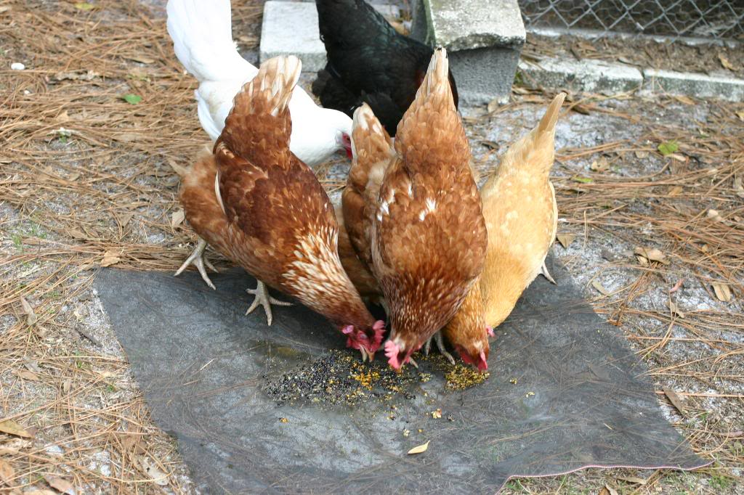
And the best one of all

Slide 9
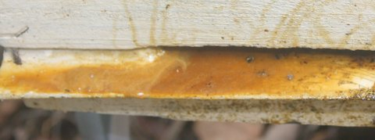
Hive entry of a slimed out brood box

Slide 10
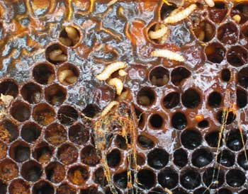
a Slimed out frame

Slide 11
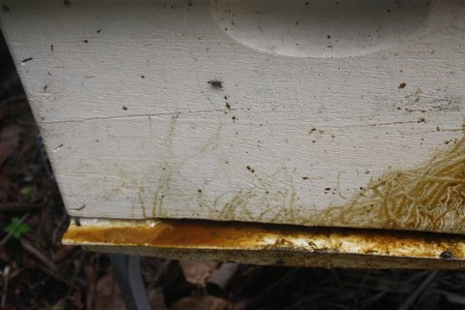
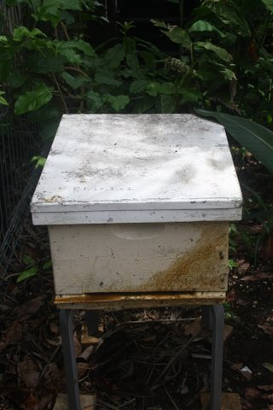
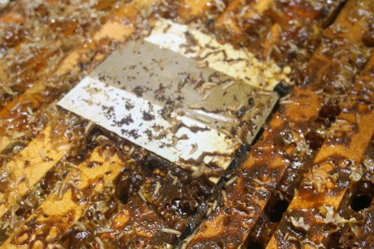
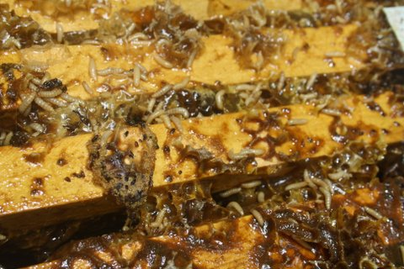
From the outside
When you life the lid off

